Slide 1
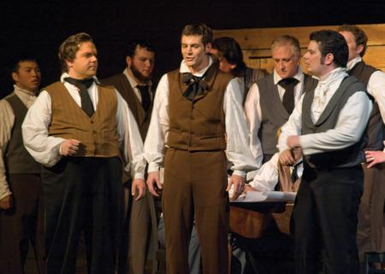
Thrust in your sickle
www.kevinhinckley.com

Slide 2
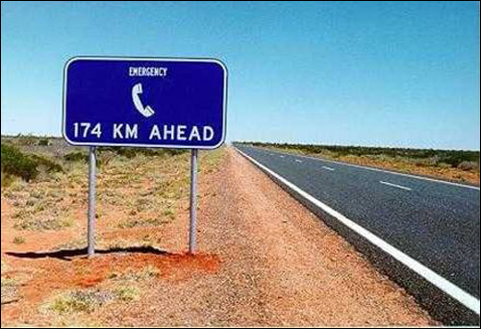
Australia

Slide 3
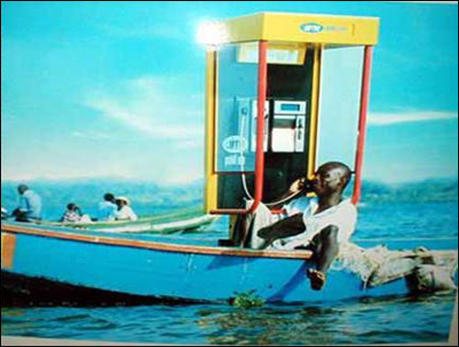
Dominican Republic

Slide 4
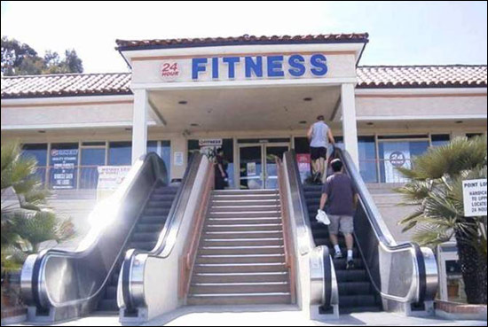
California

Slide 5
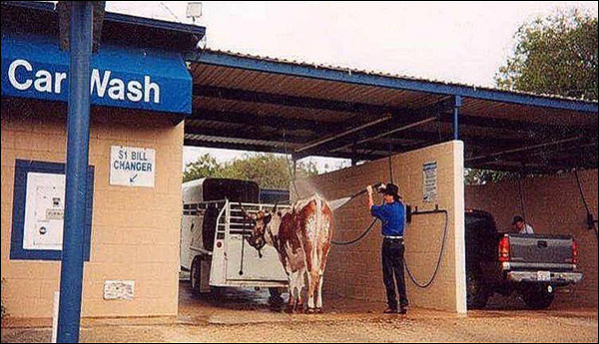
Texas…

Slide 6
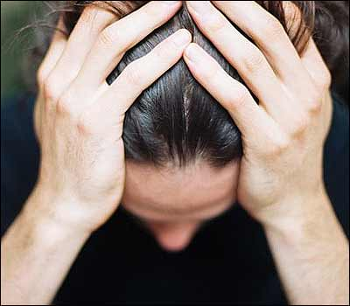
The Whitmers
D&C 30:3
Why (5 Reasons, v. 1,2)
1)…you have feared man
2)…have not relied on me for strength
3)…mind has been on the things of the earth more than on the things of me…and the ministry
4)…have not given heed unto my Spirit and to those who were set over you
5)…have been persuaded by those whom I have not commanded

Slide 7
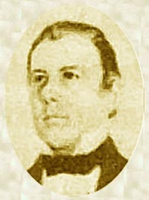
Thomas B. Marsh
16 Pages
D&C 31:2,5,9
Family

Slide 8
Brigham Young
"Let the father and mother, who are members of this Church and kingdom, take a righteous course, and strive with all their might never to do a wrong, but to do good all their lives;
if they have one child or one hundred children, if they conduct themselves towards them as they should, binding them to the Lord by their faith and prayers, I care not where those children go,
they are bound up to their parents by an everlasting tie, and no power on earth or hell can separate them from their parents in eternity; they will return again to the fountain from whence they sprang"
(in Journal of Discourses, 11:215; emphasis added).

Slide 9
Robert Millett
there seems to be, in the sermons and writings of the prophets, the quiet but soul-satisfying message that the alms of the prayers of the righteous do come up into the ears of the Lord …
that righteous parents' loyalty to their covenants will not be overlooked; that no amount of suffering of the faithful in behalf of their posterity will be for naught;
and that there is power, remarkable power, in the covenant to save those who will be saved.
As Elder Packer suggested, it may be that the power of evil in these last days is so oppressive that it chokes or restrains the proper exercise of agency.
One day that will change.

Slide 10
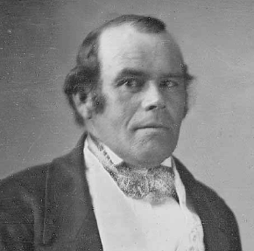
Parley P. Pratt
D&C 32: 1-3

Slide 11
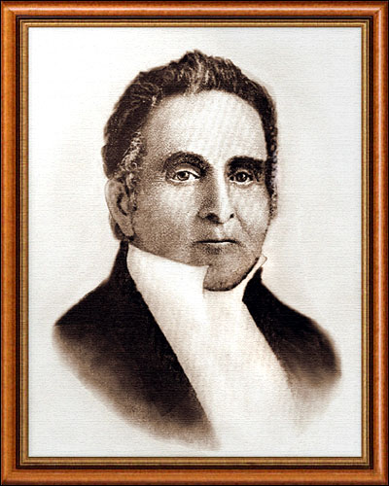
Sidney Rigdon
D&C 35: 3,4

Slide 12
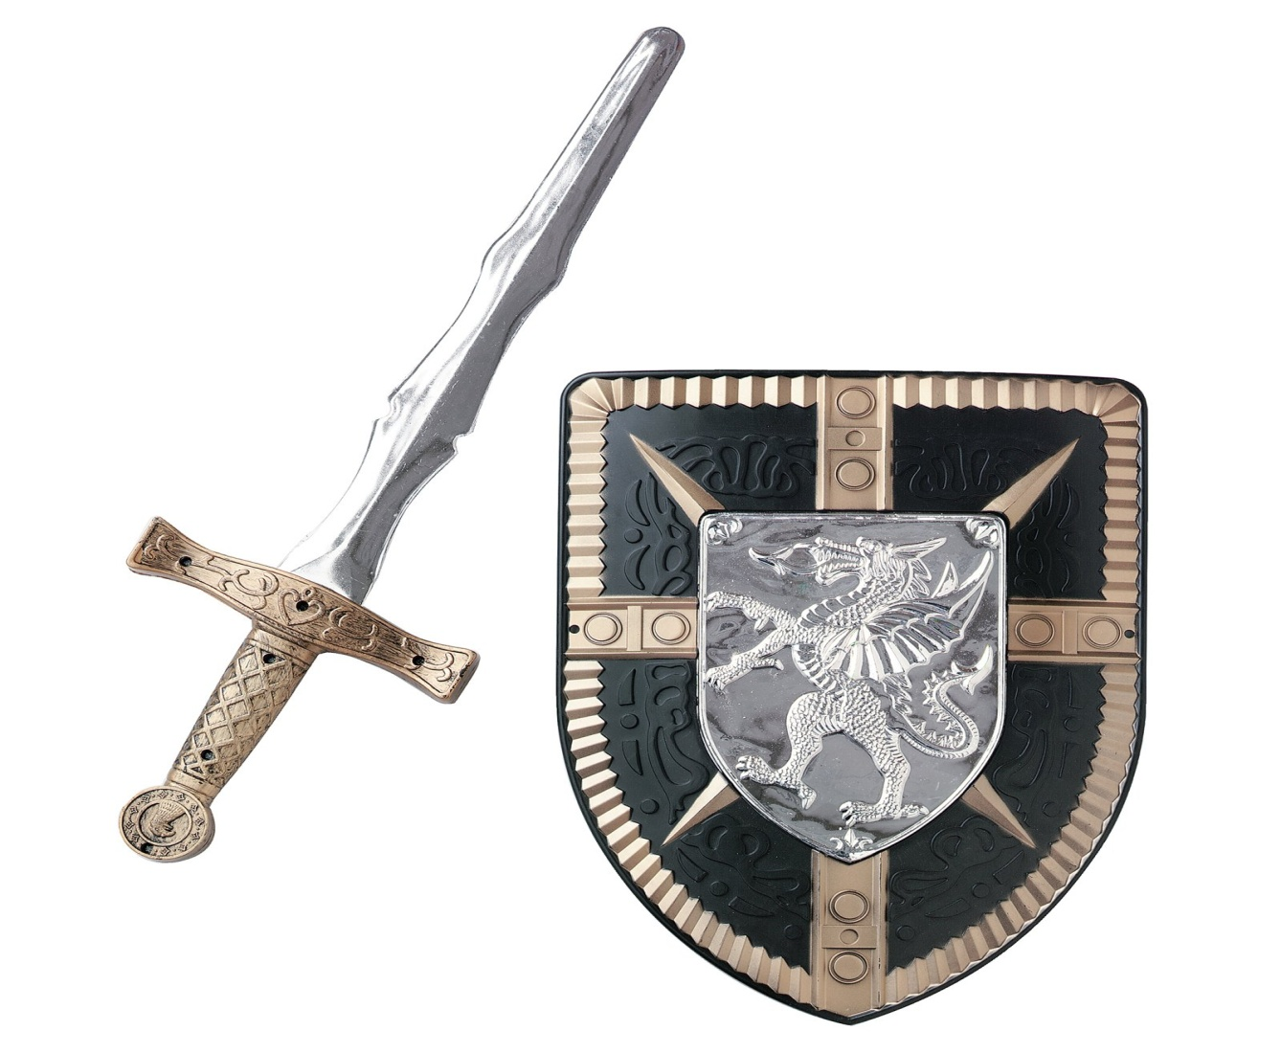
Powerful Principle
D&C 35:13,14,17

