Slide 1
Puffed Up
2 Nephi 26-29

Slide 2
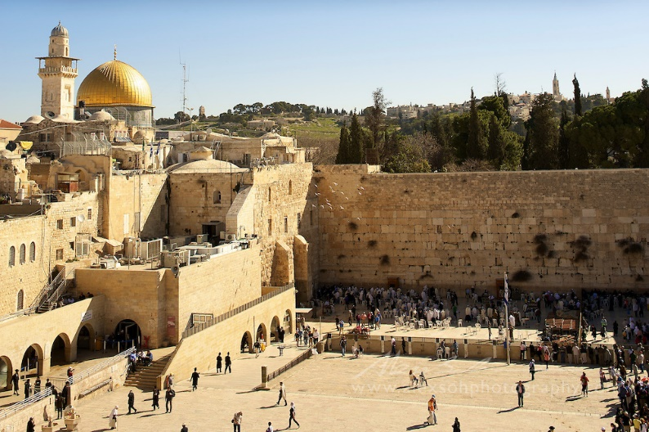
Nephi’s Final Peshar (Commentary)
His Own Visions
Isaiah (Chapter 29)
The Future: Israel, Gentiles and “his” book
Personal Revelation

Slide 3
Striving
2 Nephi 26:11

Slide 4
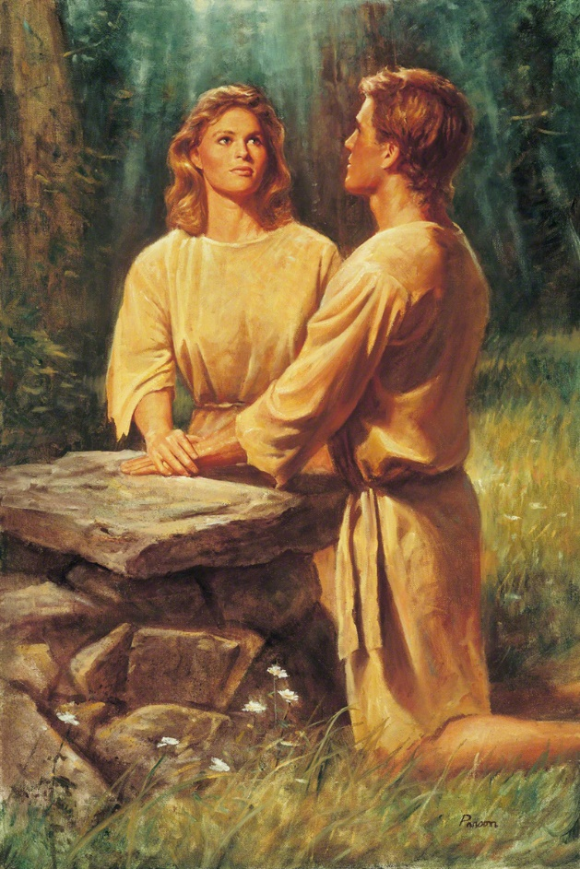
The Spirit as the Mediator
Reveals God to Man
Reveals Man to God
Romans 8:26 Likewise the Spirit also helpeth our infirmities: for we know not what we should pray for as we ought:
but the Spirit itself maketh intercession for us with groanings which cannot be [expressed].

Slide 5
Sleeping
2 Nephi 27

Slide 6
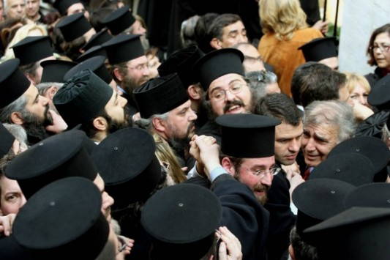
Enemies of the Book
2 Nephi 28

Slide 7
Puffing Up
2 Nephi 28:13

Slide 8
Brian Regan
Beware the Me Monster

Slide 9
CS Lewis
According to Christian teachers, the essential vice, the utmost evil, is Pride. Unchastity, anger, greed, drunkenness, and all that, are mere flea bites in comparison: it was through Pride that the devil became the devil:
Pride leads to every other vice: it is the complete anti-God state of mind…
… it is Pride which has been the chief cause of misery in every nation and every family since the world began.¹

Slide 10
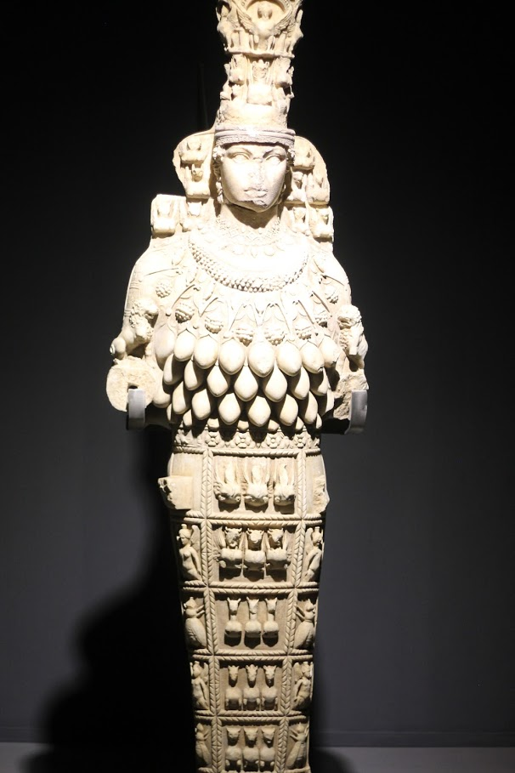
Knowledge
1 Now as touching things offered unto idols, we know that we all have knowledge. Knowledge puffeth up, but charity edifieth.
2 And if any man think that he knoweth any thing, he knoweth nothing yet as he ought to know.
3 But if any man love God, the same is known of him.

