Slide 1
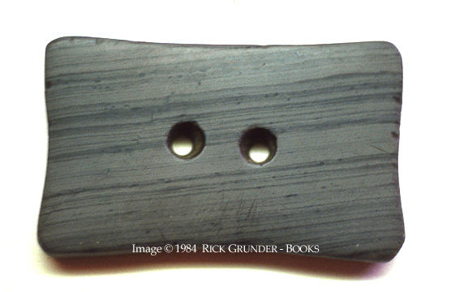
Prophets and Prophecy
www.kevinhinckley.com

Slide 2
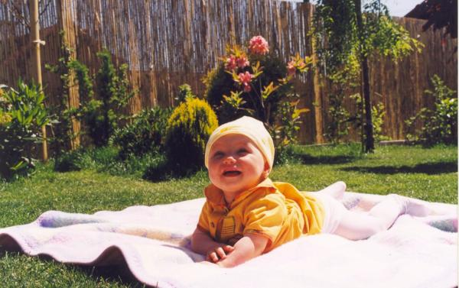
How To Take a Perfect Baby Picture Step One, Find a baby

Slide 3
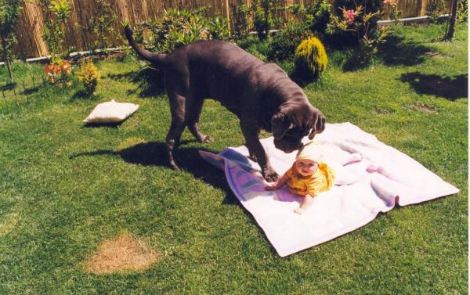
Step Two Sniff to make sure it smells right

Slide 4
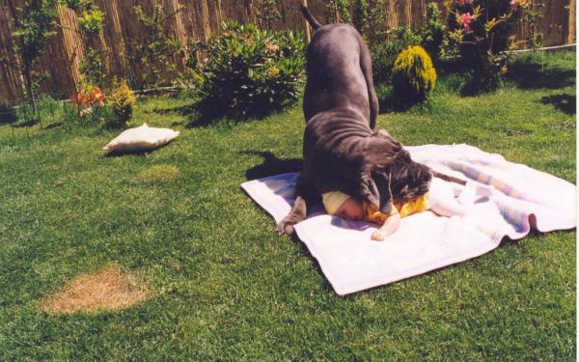
Step Three, Sit on the baby…

Slide 5
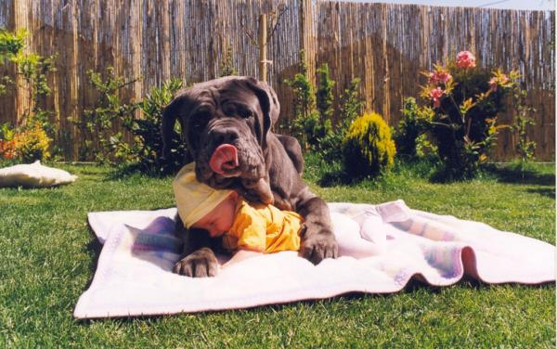
Step Four, Arrange the baby….

Slide 6
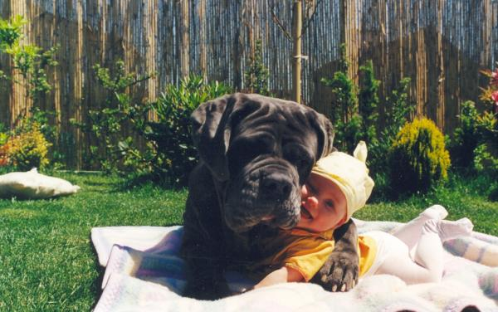
Last Step, Smile For the Camera

Slide 7
Revelation in the Church
Ether 13:2-3
Hiram Page
D&C 28

Slide 8
Dream Mine

Slide 9
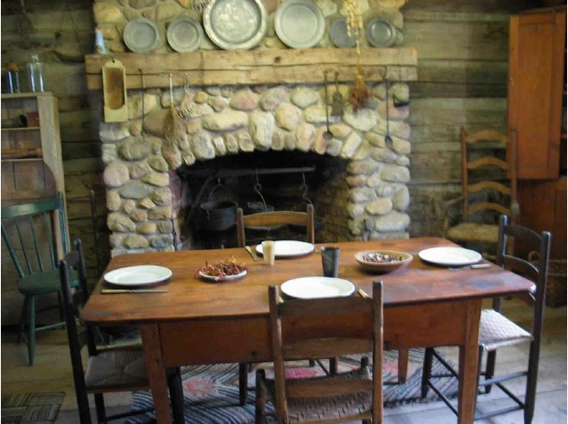
Section 29
2nd General Conference
Given in the presence of six brethren

Slide 10
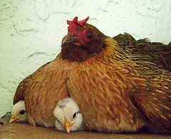
Powerful Analogy
D&C 29:2
3 Nephi 10: 5,6

Slide 11
Prayer
D&C 29:6-8

