Slide 1
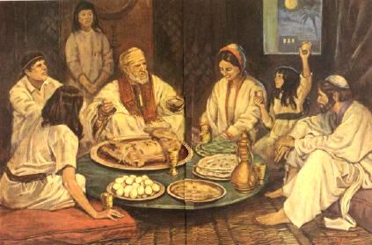
Principles with Promise
www.kevinhinckley.com

Slide 2
To Begin…
Revelation 3:19
As many as I love, I rebuke and chasten: be zealous therefore, and repent.
Question:
How do you react to chastening?

Slide 3
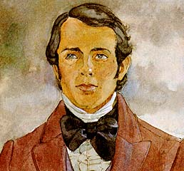
History
Bishop Edward Partridge

Slide 4
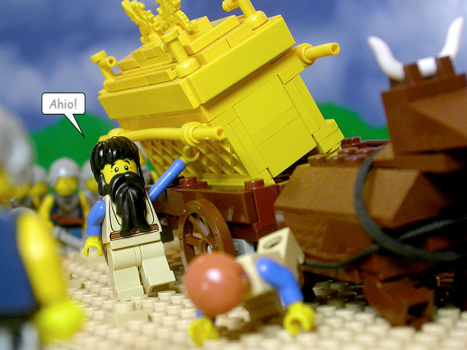
Steadying the Ark
D&C 85:6-8

Slide 5
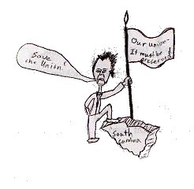
Section 87
Nullification Crisis of 1832
D&C 87

Slide 6
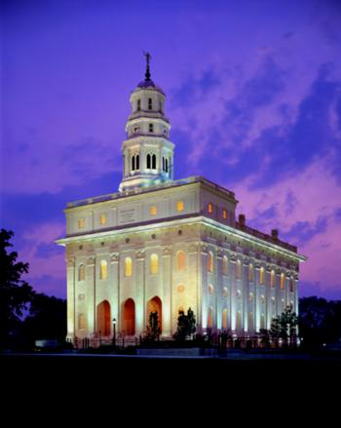
Elder Lance Wickman
…through the years I have come to appreciate the wisdom of a dear friend, a patriarch and temple sealer.
“Lance,” he said, “the joy I receive is more than just being in the temple. The temple is in me! And when I leave the temple, its peace goes with me.”
So it can be for every righteous soul. When we visit the temple as often as distance and individual circumstance permit, the temple will be in us.
Then, despite the buffetings of life, we will always be in a holy place.
1994 Oct General Conference

Slide 7
Comparison
D&C 89
18 And all saints who remember to keep and do these sayings, walking in obedience to the commandments, shall receive health in the navel and marrow to the bones.
19 And shall find wisdom and great treasures of knowledge, even hidden treasures;
20 And shall run and not be weary, and shall walk and not faint.
21 And I, the Lord, give unto them a promise, that the destroying angel shall pass by them, as the children of Israel, and not slay them. Amen.
Isaiah 40
28 ¶Hast thou not known? hast thou not heard, that the everlasting God, the Lord, the Creator of the ends of the earth, fainteth not, neither is weary?
there is no searching of his understanding.
29 He giveth power to the faint; and to them that have no might he increaseth strength.
30 Even the youths shall faint and be weary, and the young men shall utterly fall:
31 But they that wait upon the Lord shall renew their strength; they shall mount up with wings as eagles; they shall run, and not be weary; and they shall walk, and not faint.

Slide 8
Principle:
Wait upon the Lord

