Slide 1
Nephi and the Tree

Slide 4
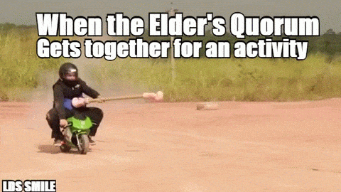

Slide 6
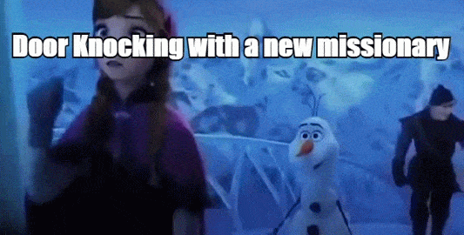

Slide 7
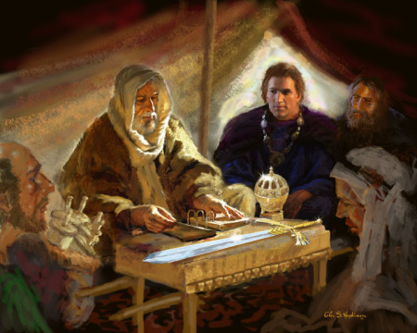
What did Lehi teach?
1 Nephi 10

Slide 8
The Temple Tent
River of Lemuel
Temple/Tent
of Lehi
Altar
Valley of Lemuel

Slide 9
Nephi’s Vision Thesis Statement
V. 17 I Nephi, was desirous also that I might see, and hear, and know of these things
By the power of the Holy Ghost, which is the gift of God unto all those who diligently seek him,
As well in times of old as in the time that he should manifest himself unto the children of men.
V. 18 For he is the same yesterday, to-day and forever
And the way is prepared….
V. 19 For he that diligently seeketh shall find; and mysteries of God shall be unfolded unto them
By the power of the Holy Ghost
As well in these times as in the times of old and as well in times of old and as in times to come;
Wherefore, the course of the Lord is one eternal round.
Therefore remember, O man….

Slide 10
What Desirest Thou?
1 Nephi 11:1

Slide 11
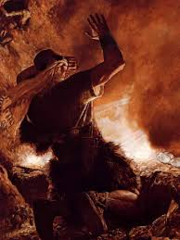
Nephi’s Steps for Knowing
Questions of the Spirit
1- What desirest thou?
Desiring!
2- Believest thou?
Believing!
3- Look! (and see the signs)
Seeing!

Slide 12
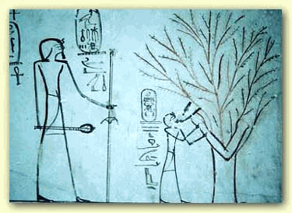
The Seed and the Tree
1 Nephi 11:8
Alma 32:37

Slide 13
Question
How do you respond when you ‘do not know the meaning’?
How do you respond to doubt?

