Slide 1
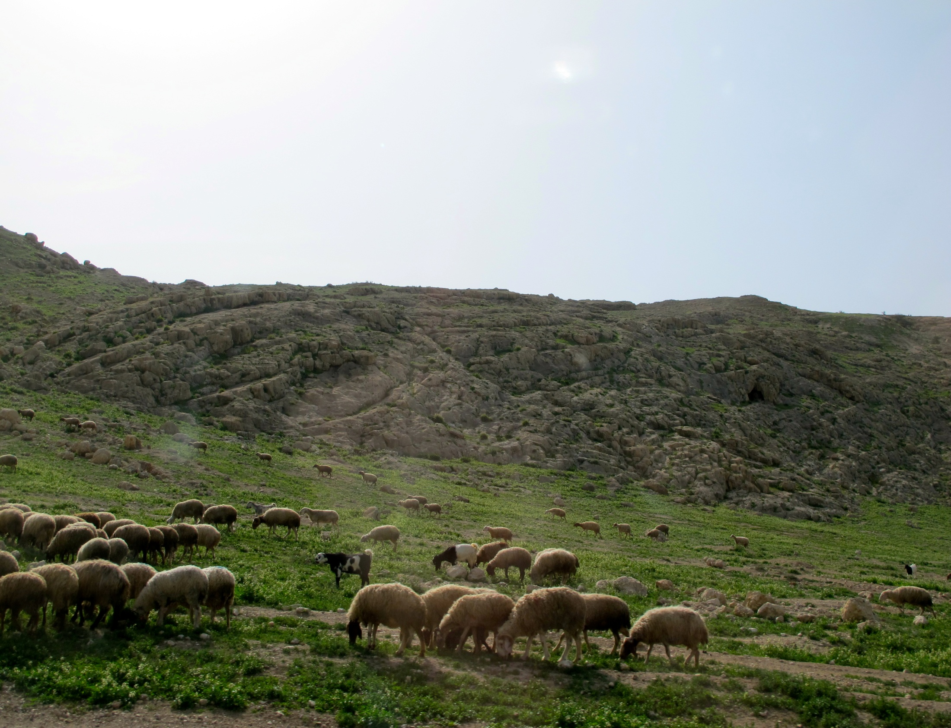
Matt 2, Luke 2

Slide 2
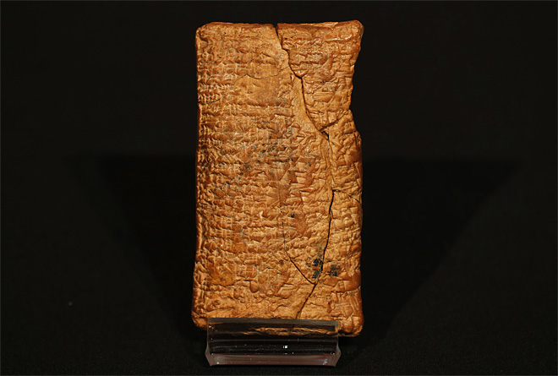
LONDON (AP) — It was a vast boat that saved two of each animal and a handful of humans from a catastrophic flood.
But forget all those images of a long vessel with a pointy bow — the original Noah's Ark, new research suggests, was round.
A recently deciphered 4,000-year-old clay tablet from ancient Mesopotamia — modern-day Iraq — reveals striking new details about the roots of the Old Testament tale of Noah.
It tells a similar story, complete with detailed instructions for building a giant round vessel known as a coracle — as well as the key instruction that animals should enter "two by two.“
The tablet went on display at the British Museum on Friday, and soon engineers will follow the ancient instructions to see whether the vessel could actually have sailed.

Slide 3
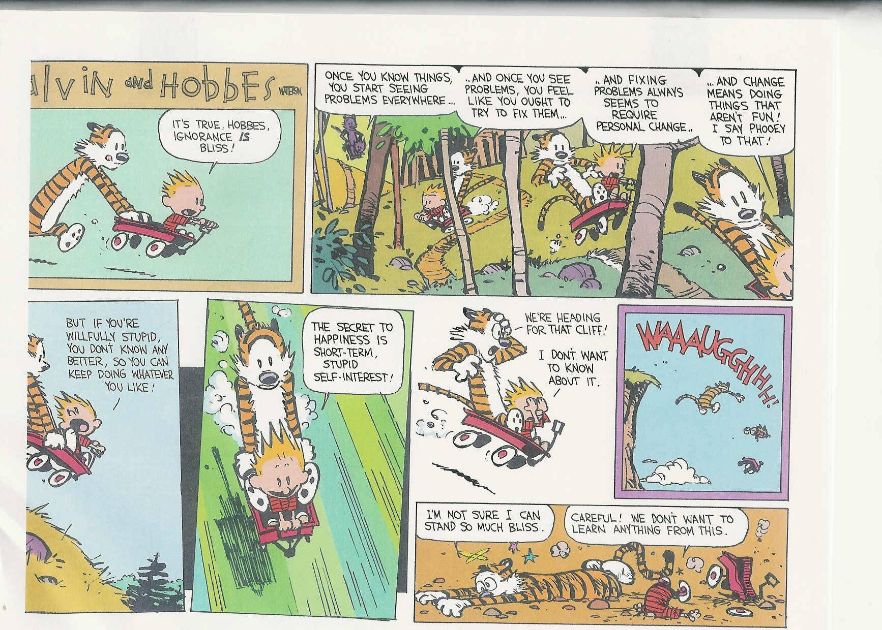

Slide 4
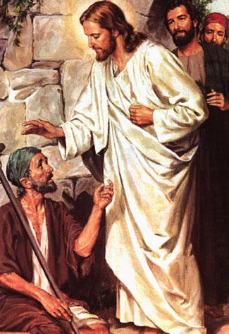
Nephi
1 Nephi 11: 12

Slide 5
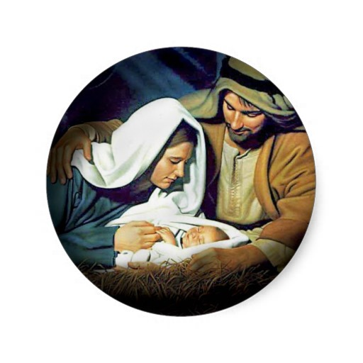
Lectures on Faith
one reason Jesus Christ is called the Son of God is because He
“descended in suffering below that which man can suffer; or, in other words, suffered greater sufferings,
and was exposed to more powerful contradictions than any man can be.

Slide 6
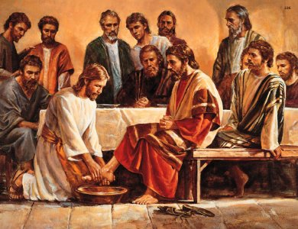
Elder Edgly
When the God of this earth, the greatest of all, knelt at the feet of His disciples, He was teaching more than the fundamentals of foot washing.
Some of the words associated with Christ’s condescension
are descend, love, mercy, grace, suffering, submission, obedience, service, sacrifice, redeem, humility,minister,judged, and slain.
2001 Dec Ensign

Slide 7
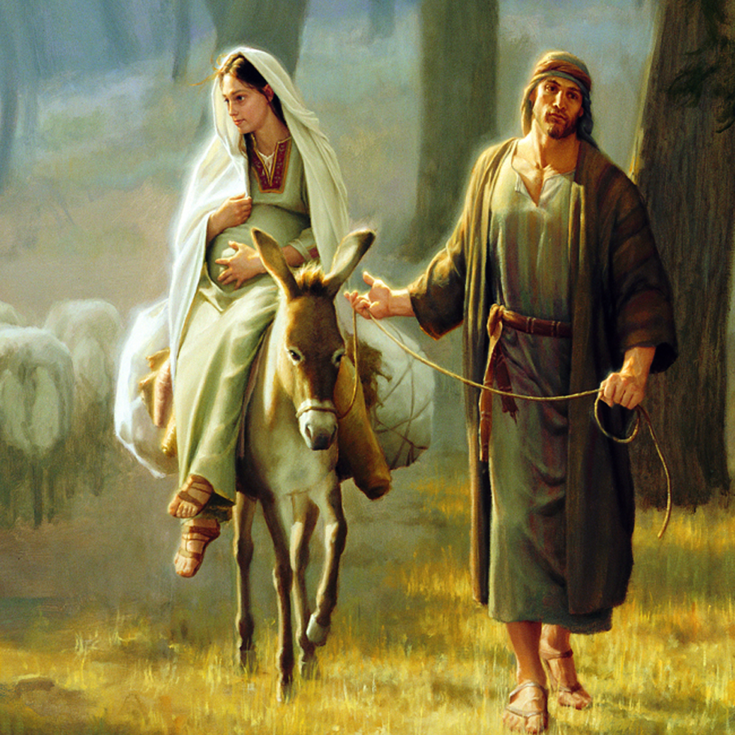
No Room….
Luke 2

Slide 8
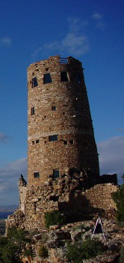
Elder Gerald Lund
One of these verses is frequently misquoted: "Keeping watch over their flocks by night." But the verse does not say flocks, plural, but flock, singular.
One scholar explained the significance: "There was near Bethlehem, on the road to Jerusalem, a tower known as Migdal Eder, or the watchtower of the flock. Here was the station where shepherds watched the flocks destined for sacrifice in the temple. . . .
It was a settled conviction among the Jews that the Messiah was to be born in Bethlehem, and equally that he was to be revealed from Migdal Eder. The beautiful significance of the revelation of the infant Christ to shepherds watching the flocks destined for sacrifice needs no comment.
The flock mentioned in the scripture, then, apparently was the one used for temple sacrifices, and the shepherds thus had responsibility for the most important flock in the region.
(Gerald N. Lund, Selected Writings of Gerald N. Lund: Gospel Scholars Series , p.144)

Slide 9
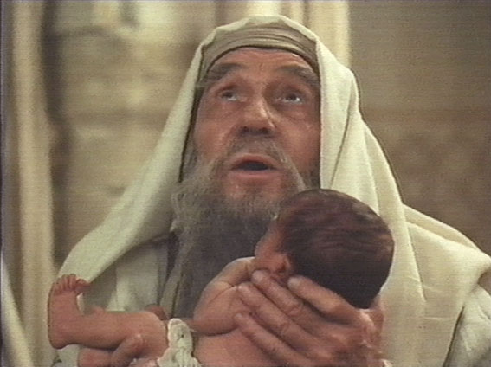
Therefore, what?
Luke 2:34,35

Slide 10
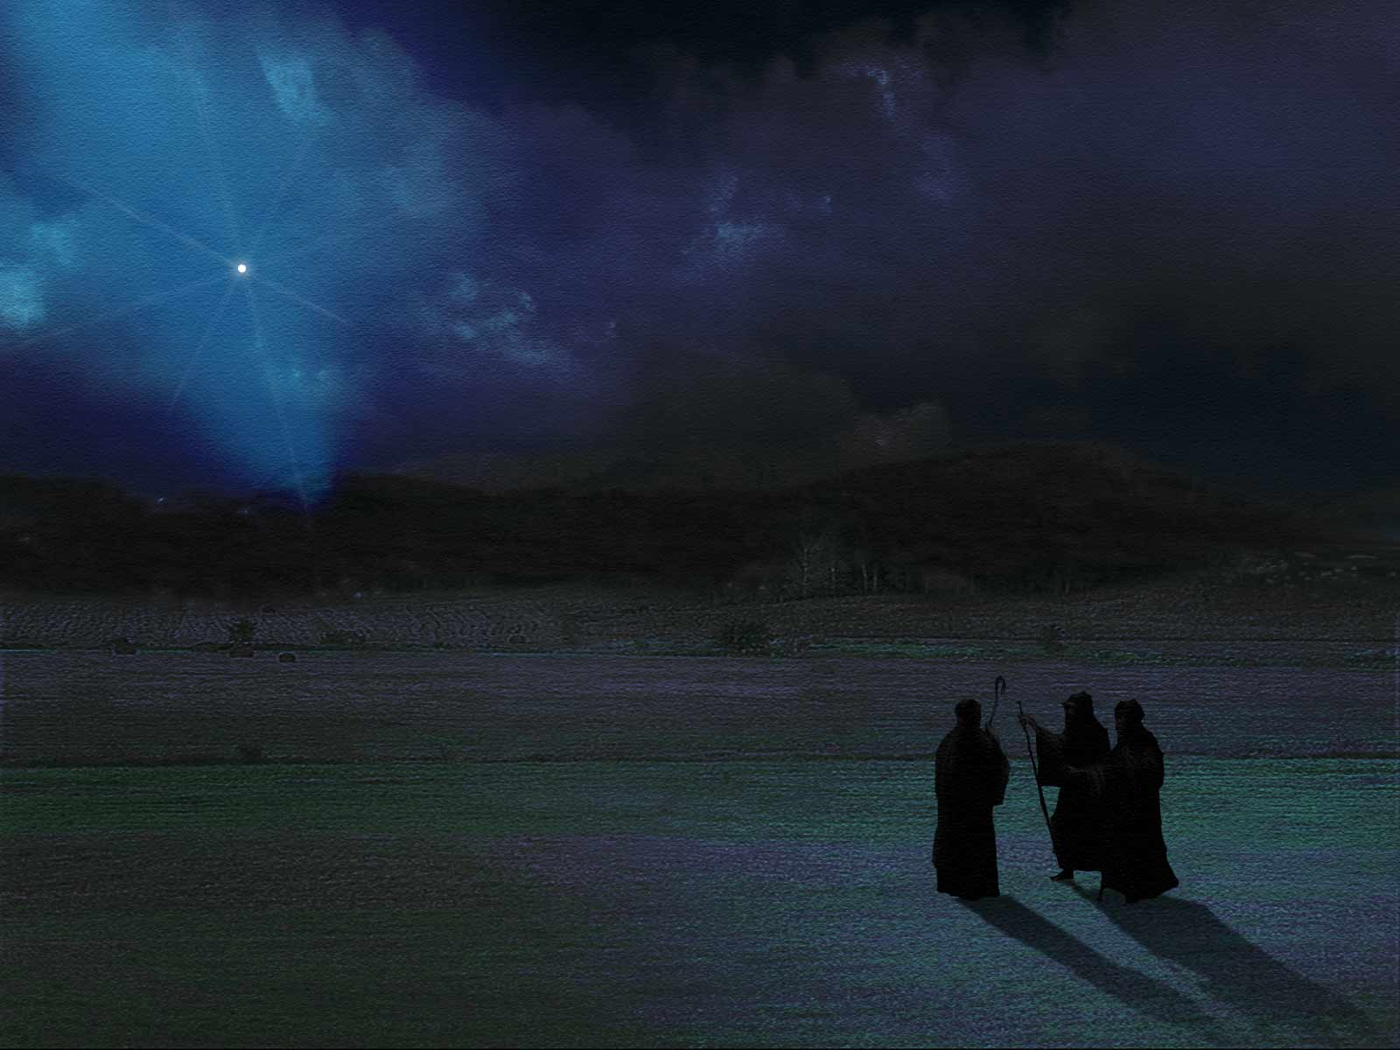
Elder CS Lewis
"I am trying here to prevent anyone saying the really foolish thing that people often say about Him: 'I'm ready to accept Jesus as a great moral teacher, but I don't accept His claim to be God.'
That is the one thing we must not say. A man who was merely a man and said the sort of things Jesus said would not be a great moral teacher.
He would either be a lunatic -‑ on a level with the man who says he is a poached egg ‑- or else he would be the Devil of Hell. You must make your choice. Either this man was, and is, the son of God: or else a madman or something worse."
"You can shut Him up for a fool, you can spit at Him and kill Him as a demon; or you can fall at His feet and call Him Lord and God. But let us not come up with any patronizing nonsense about His being a great human teacher. He has not left that open to us. He did not intend to."

