Slide 1
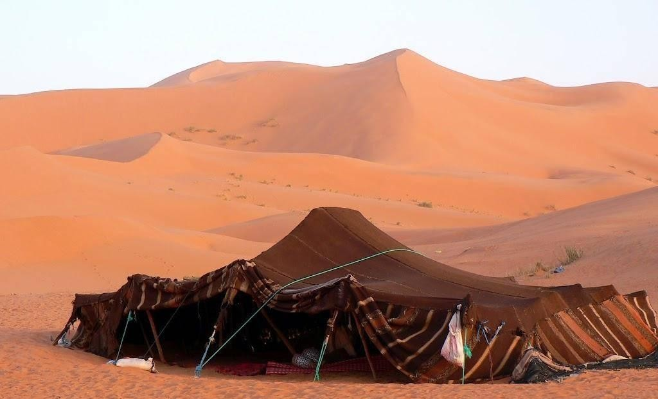
Lehi in the wilderness
1 Nephi 16

Slide 2
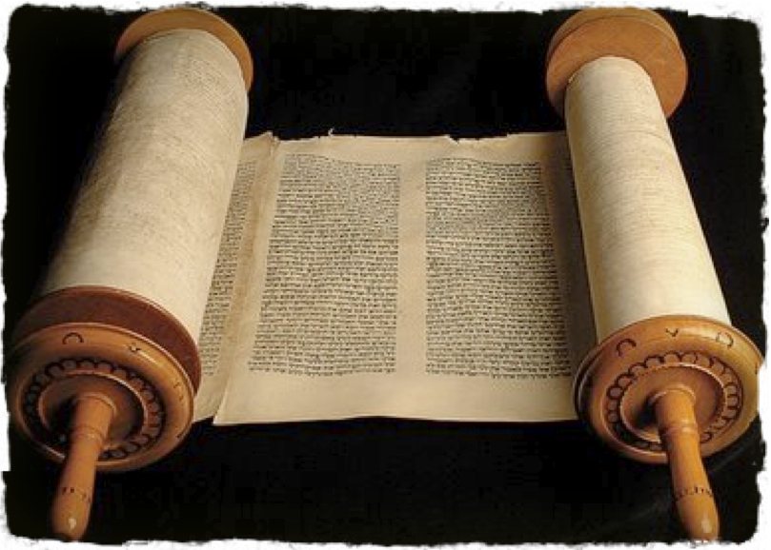
Reminder…
Believing Deuteronomists…
Prophets receive revelation only to interpret the Law
Salvation comes through the Law of Moses
Salvation will come only to blood Israel
Ordinances can only take place at the Temple at Jerusalem

Slide 3
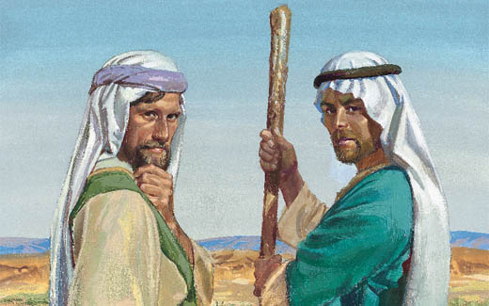
We cannot (will not) understand
1 Nephi 15

Slide 4
Three part Key to personal revelation
Open, Soft Heart
Asking and Believing
Personal Obedience

Slide 5
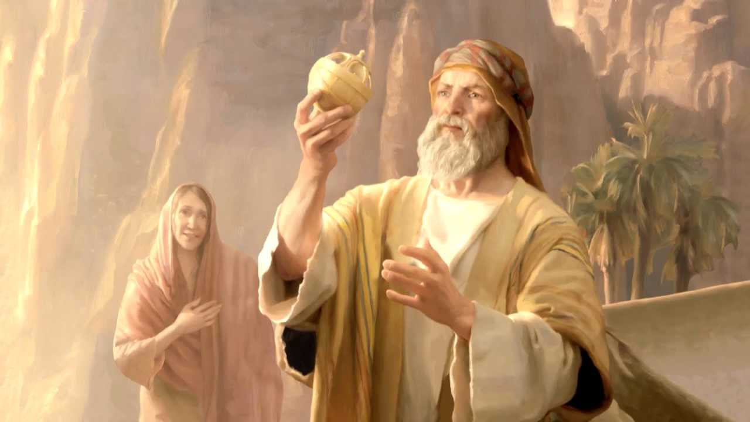
The compass
1 Nephi 16:9

Slide 6
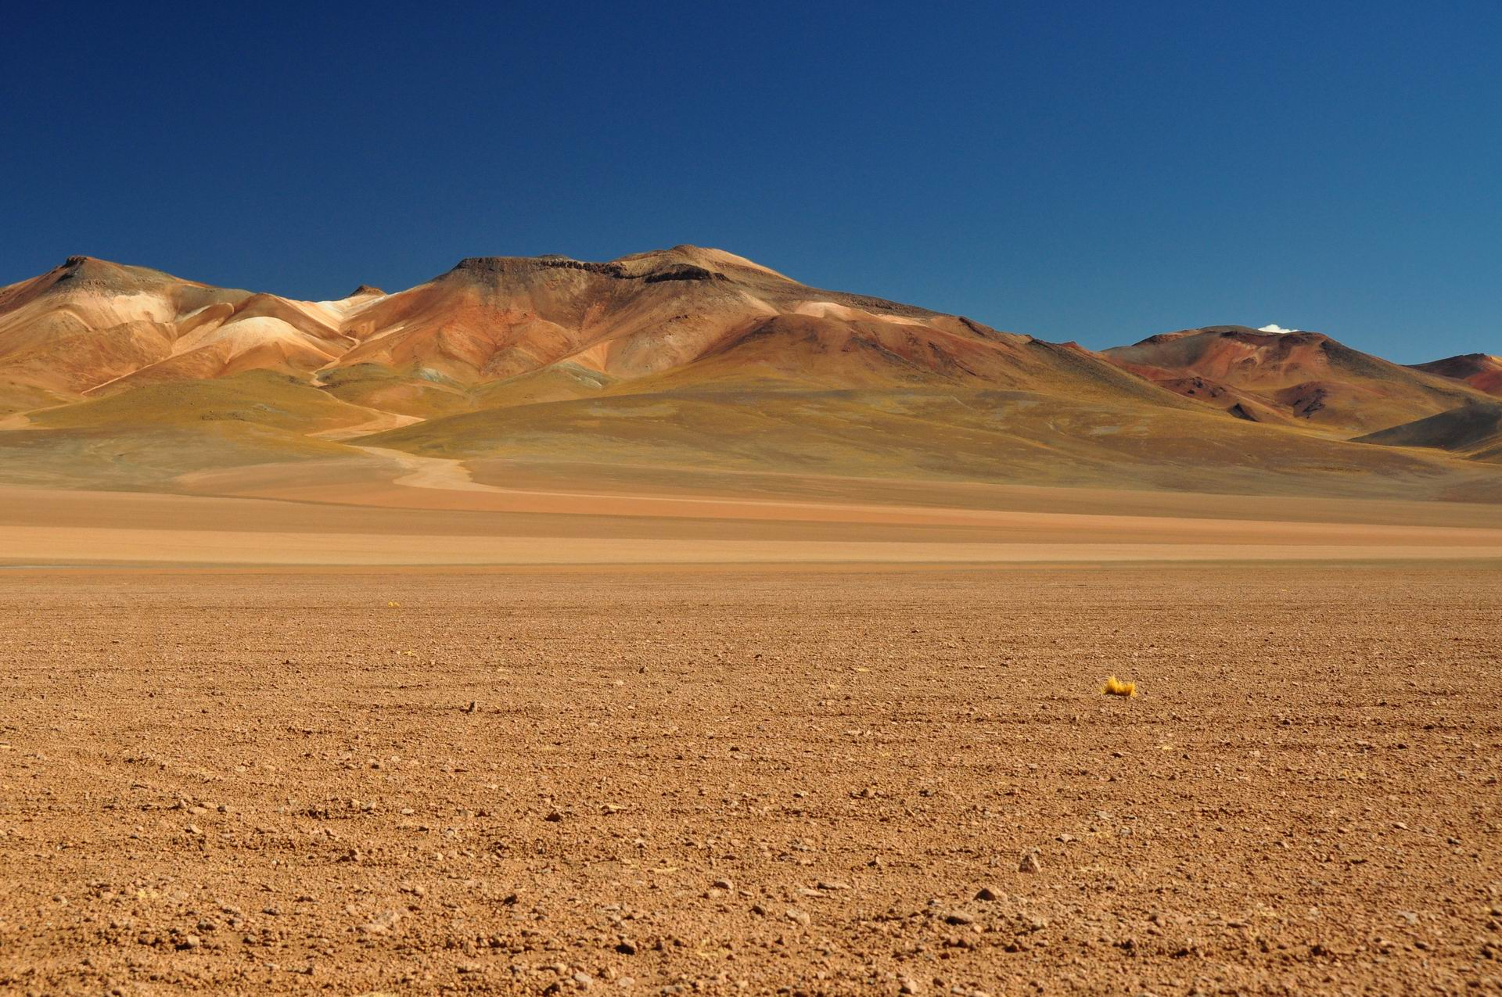
Iron Rod principles but liahona lives
Liahona Lives
1) Clear direction, but no step by step path
2) Our direct course can be altered by doubts (1 Nephi 16:38)
3) Our direct course can be altered by forgetting (Alma 37:41)

Slide 7
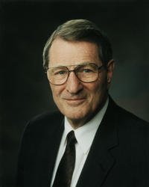
Neal Maxwell-- Murmuring
First, the murmurer often lacks the courage to express openly his concerns…
Second, murmurers make good conversational cloak holders. Though picking up no stones themselves, they provoke others to do so.
Third, while a murmurer insists on venting his own feelings, he regards any response thereto as hostile. Furthermore, murmurers seldom take into account the bearing capacity of their audiences.
Fourth, murmurers have short memories. Strange, isn’t it, brothers and sisters, how those with the shortest memories have the longest lists of demands! However, with no remembrance of past blessings, there is no perspective about what is really going on.
“‘Murmur Not’,” Ensign, Nov 1989, 82

Slide 8
How do you see things?
Laman and Lemuel
…and we have wandered in the wilderness for these many years; and our women have toiled, being big with child; and they have borne children in the wilderness and suffered all things, save it were death; and it would have been better that they had died before they came out of Jerusalem than to have suffered these afflictions.
Behold, these many years we have suffered in the wilderness, which time we might have enjoyed our possessions and the land of our inheritance; yea, and we might have been happy.
Nephi
And so great were the blessings of the Lord upon us, that while we did live upon raw meat in the wilderness, our women did give plenty of suck for their children, and were strong, yea, even like unto the men; and they began to bear their journeyings without murmurings.
And thus we see that the commandments of God must be fulfilled. And if it so be that the children of men keep the commandments of God he doth nourish them, and strengthen them, and provide means whereby they can accomplish the thing which he has commanded them;

