Slide 1
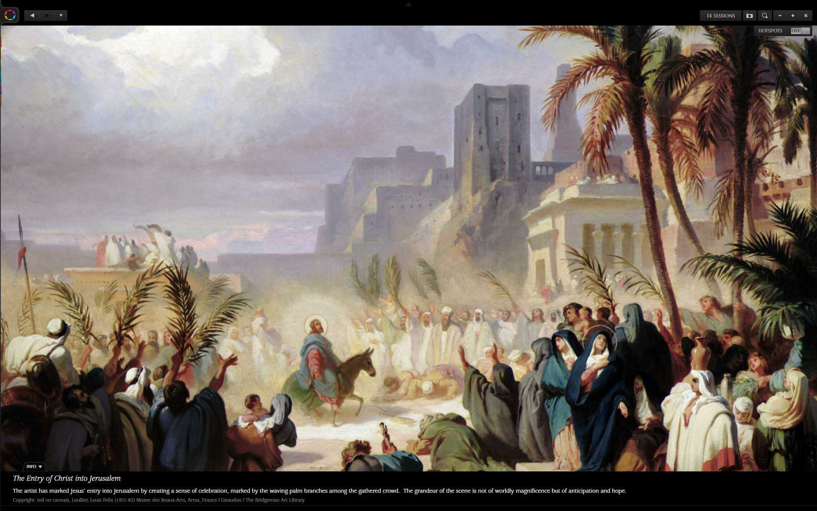
Hosanna!

Slide 2
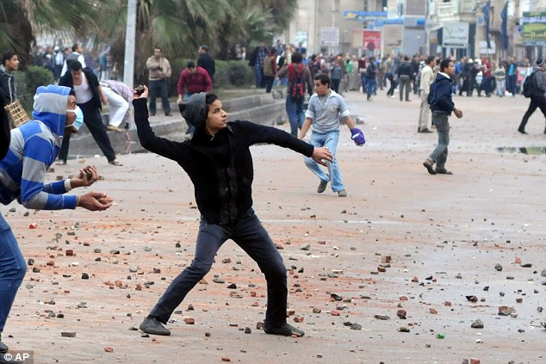
Old English minister
We have just enough religion to hate each other,
But not yet enough to love one another….

Slide 3
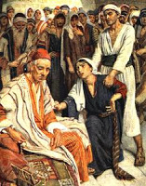
Parable #1 The importuning Widow
Luke 18:1

Slide 4
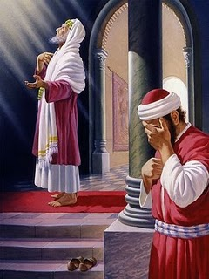
Parable #2 The Pharisee and the publican
Luke 18:9

Slide 5
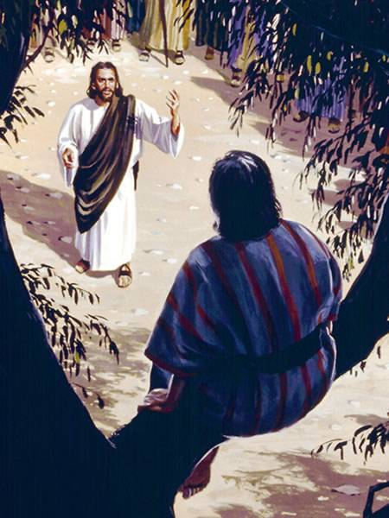
Zacchaeus
Luke 19:1

Slide 6
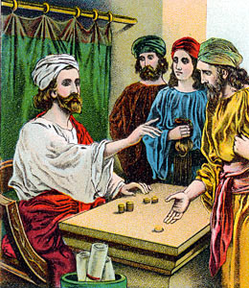
The Nobleman
Luke 19:11

Slide 7
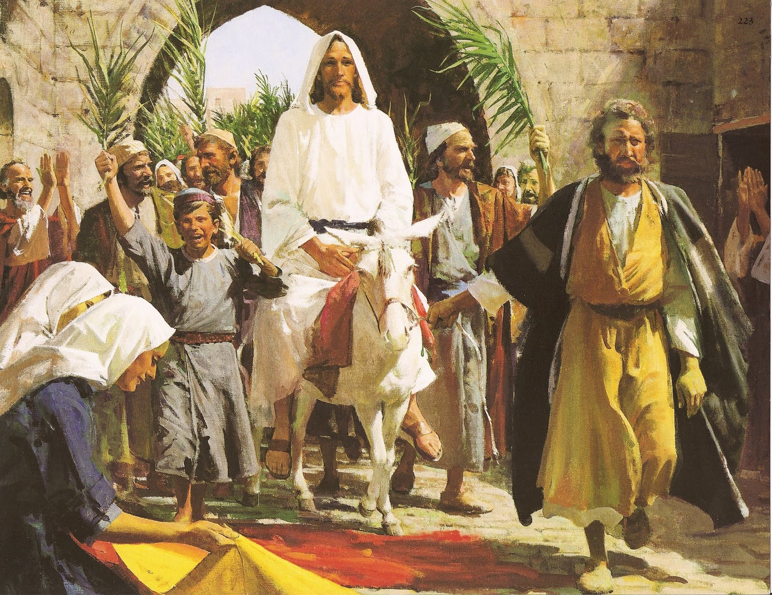
The triumphal entry
Luke 19:28
Matthew 21:1
Zechariah 9:9

