Slide 1
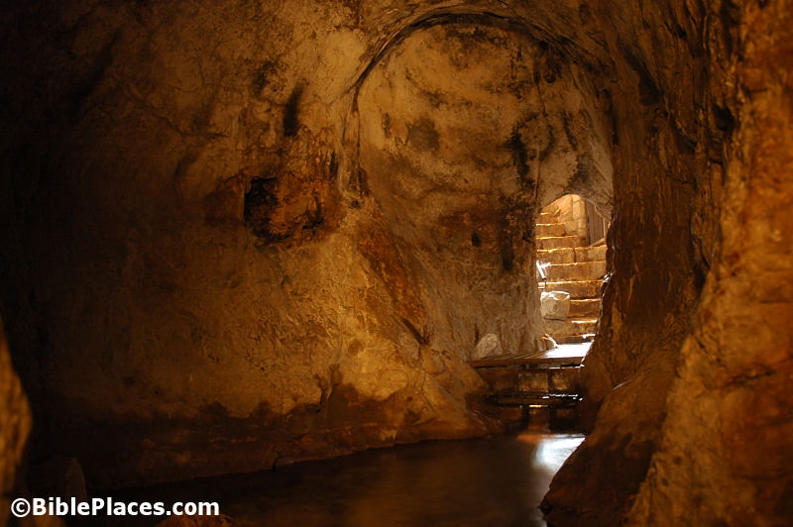
It is in my heart to make a covenant…
Hezekiah

Slide 2
D&C 95
1 Verily, thus saith the Lord unto you whom I love, and whom I love I also chasten that their sins may be forgiven, for with the chastisement I prepare a way for their deliverance in all things out of temptation, and I have loved you—
2 Wherefore, ye must needs be chastened and stand rebuked before my face;
3 For ye have sinned against me a very grievous sin, in that ye have not considered the great commandment in all things,
that I have given unto you concerning the building of mine house;

Slide 3
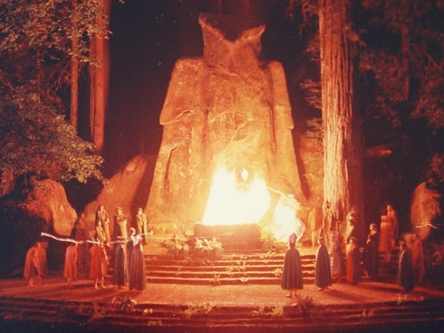
King Ahaz
Under King Ahaz
Temple Shuttered, Ba’al worshipping the standard
No Torah or available scriptures
In bondage and paying tributes to the Syrians
Syrians have partially captured upper 10 tribes of Israel
About 100 years before Lehi and the fall of Jerusalem

Slide 4
King Ahaz
2 Chronicles 28:23
For he sacrificed unto the gods of Damascus, which smote him: and he said,
Because the gods of the kings of Syria help them, therefore will I sacrifice to them, that they may help me.
But they were the ruin of him, and of all Israel.

Slide 5
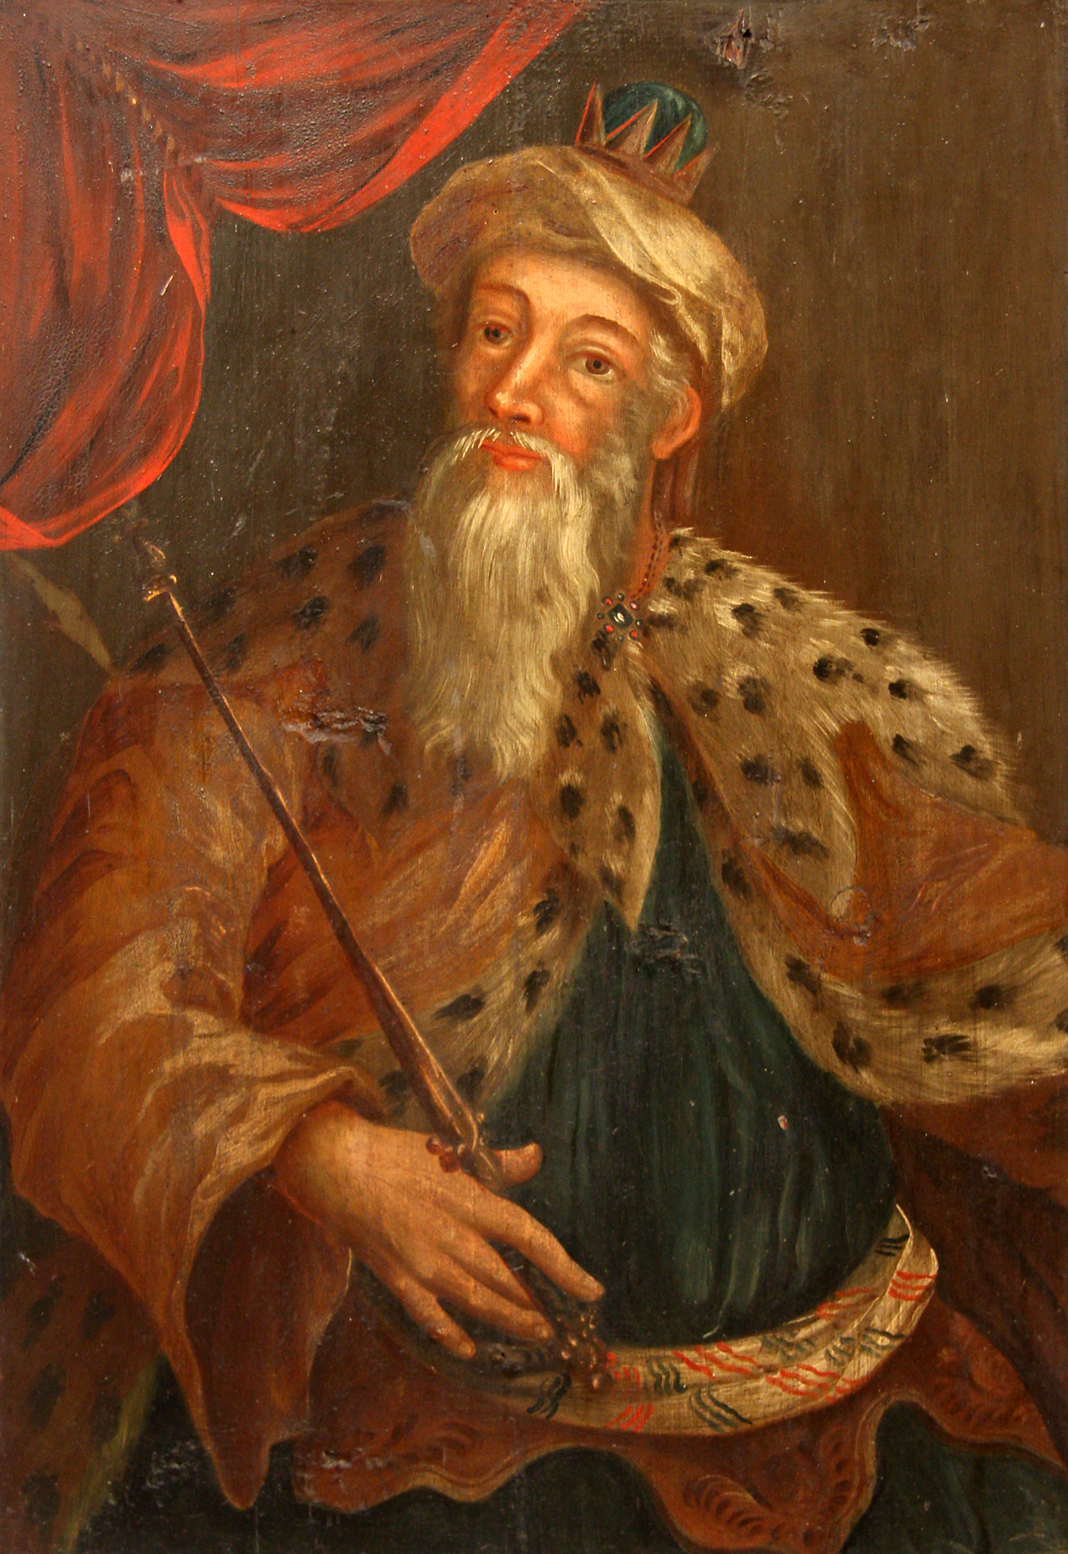
King Hezekiah
2 Chronicles 29:1
2 Kings 18:1-4

Slide 6
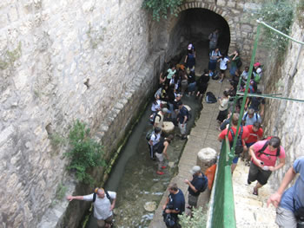
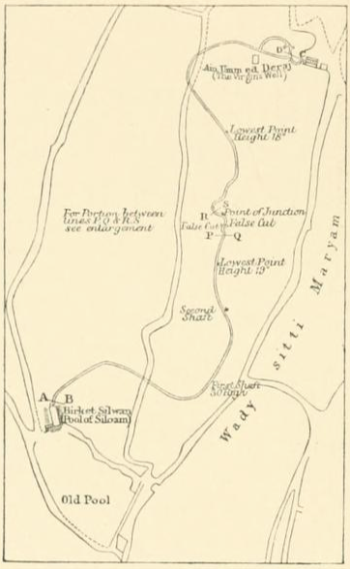
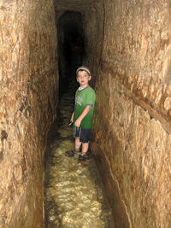
Water
2 Chronicles 32:30
This same Hezekiah also stopped the upper watercourse of Gihon, and brought it straight down to the west side of the city of David. And Hezekiah prospered in all his works.

Slide 7
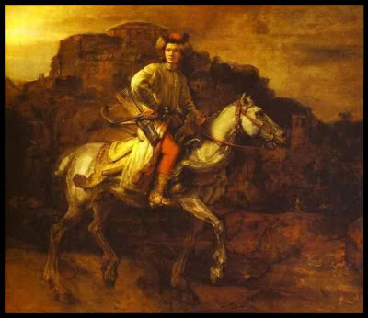
Invitations
2 Chronicles 30:1-10

Slide 8
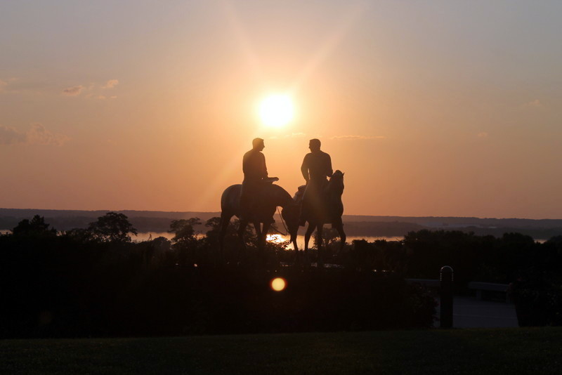
Proclamation from Zion 1841
D&C 124
….to all the kings of the world, to the four corners thereof, to the honorable president-elect, and the high-minded governors of the nation in which you live, and to all the nations of the earth scattered abroad. (Let it be written in the spirit of meekness and by the power of the Holy Ghost.’)
‘The day of my visitation cometh speedily, in an hour when ye think not of; and where shall be the safety of my people, and refuge for those who shall be left of them?
Awake, O kings of the earth! Come ye, O, come ye, with your gold and your silver, to the help of my people, to the house of the daughters of Zion.’

Slide 9
Hezekiah’s Illness and Delivery
2 Chronicles 32:24
Isaiah 38:1-6

Slide 10
St. Hugh Nibley
By a great miracle King Hezekiah of Judah was snatched from death and given fifteen more years of life. In an outburst of joy and gratitude he voiced his thanks and his infinite relief at knowing that God was able to give whatever one asked of him, even life itself; what is the security of all the world's wealth in comparison to that?
And then a significant thing happened. Ambassadors arrived from Babylon, and Hezekiah simply could not resist showing them through his treasury, displaying his wealth and power. "Then came Isaiah the prophet unto King Hezekiah, and said unto him, What said these men? and from whence came they unto thee? And Hezekiah said, They are come from . . . Babylon.
Then said he, What have they seen in thine house? And Hezekiah answered, All that is in mine house have they seen. Then said Isaiah to Hezekiah, Hear the word of the Lord of hosts: Behold, the days come, that all that is in thine house . . . shall be carried to Babylon." (Isaiah 39:3-6.)
The man couldn't resist showing off, and by his vanity he only whetted their greed. They liked what they saw and came back later to fetch it. He had played right into their hands.
(Old Testament and Related Studies, Deseret Book Co., FARMS, 1986], 230)

