Slide 1
He Lives!

Slide 2
Question
How do Latter Day Saints differ from the world, in the way we view our physical bodies?

Slide 3
2006 National Poll of Christians…
65% were “absolutely certain” Jesus was physically resurrected.
36% believe in their own resurrection
Joseph Smith:
...for if there be no resurrection from the dead, then Christ has not risen; and if Christ has not risen He was not the Son of God; and if He was not the Son of God, there is not nor cannot be a Son of God, if the present book called the Scriptures is true; because the time has gone by when, according to that book, He was to make His appearance." (TPJS, p62)

Slide 4
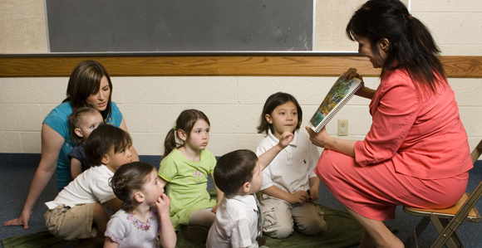
Answers to Gospel Questions 1, p. 29
"While telling the story of the resurrection of Jesus, one of the children asked, 'Why did Jesus come alive again?'
The only answer I could give was that he was so good that he just could not stay dead. I have read the scriptures on the crucifixion, but cannot seem to get the full reason for the necessity of his death, and how he had the power over death. Will you please explain this to me as it is given in the scriptures?“

Slide 5
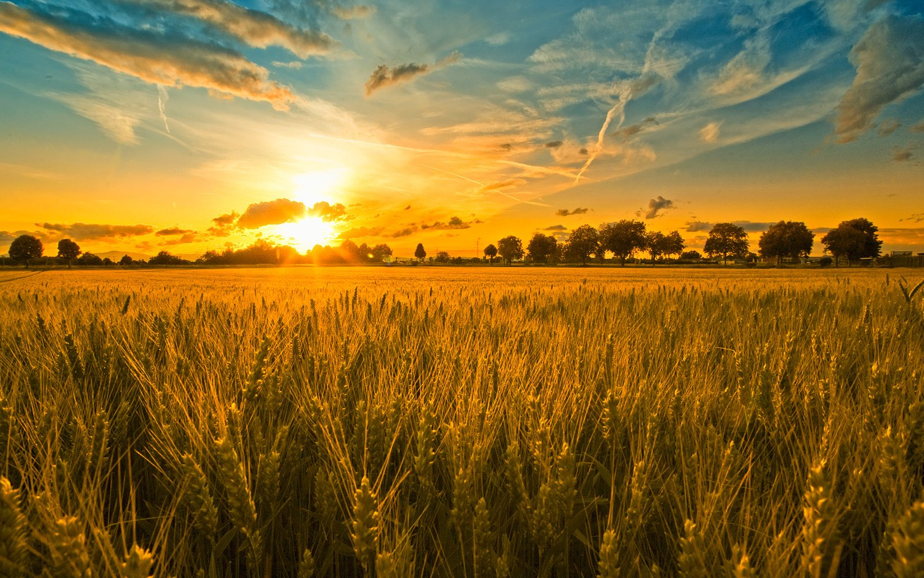
The First Day
John 20:1

Slide 6
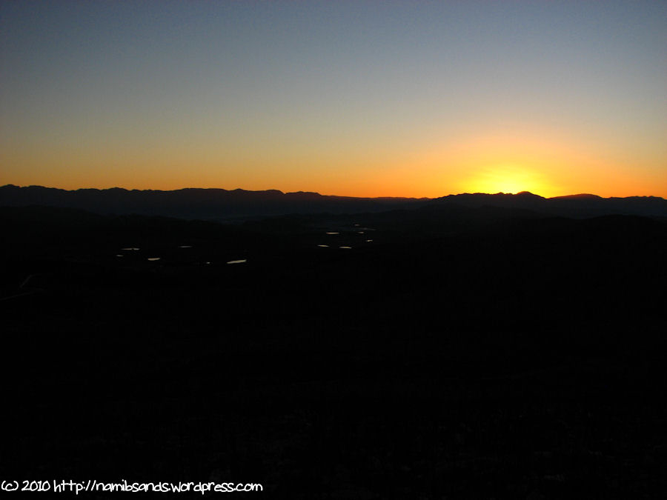
Amalgamated Version
In the end of the Sabbath day, as it began to dawn towards the first day of the week, early in the morning, came Mary Magdalene, and the other Mary to see the sepulcher.
two angels of the Lord descended from heaven, and came and rolled back the stone from the door, and sat upon it and [the women] seeth the stone taken away from the sepulcher, and two angels sitting thereon.
And their countenance was like lightning, and their raiment white as snow; and for fear of them the keepers did shake, and became as though they were dead.
And the angels answered and said unto the women, Fear not ye; for we know that ye seek Jesus who was crucified.
He is not here, but is risen. Remember how he spake unto you when he was yet in Galilee,
Saying, The Son of man must be delivered into the hands of sinful men, and be crucified, and the third day rise again?
Come, see the place where the Lord lay; and go quickly, and tell his disciples that he is risen from the dead; and, behold, he goeth before you into Galilee; there shall ye see him; lo, I have told you.

Slide 7
Amalgamated Version Continued
And they departed quickly from the sepulcher, with fear and great joy; and did run to bring his disciples word…and told all these things unto the eleven, and to all the rest.

Slide 8
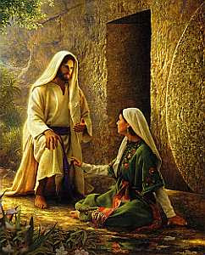
Runners….
7 ¶How beautiful upon the mountains are the feet of him that bringeth good tidings, that publisheth peace; that bringeth good tidings of good, that publisheth salvation; that saith unto Zion, Thy God reigneth!
8 Thy watchmen shall lift up the voice; with the voice together shall they sing: for they shall see eye to eye, when the Lord shall bring again Zion.
9 ¶Break forth into joy, sing together, ye waste places of Jerusalem: for the Lord hath comforted his people, he hath redeemed Jerusalem.

Slide 9
Good Tidings
And David sat between the two gates: and the watchman went up to the roof over the gate unto the wall, and lifted up his eyes, and looked, and behold a man running alone. And the watchman cried, and told the king.
And the king said, If he be alone, there is tidings in his mouth. And he came apace, and drew near. And the watchman saw another man running: and the watchman called unto the porter, and said, Behold another man running alone. And the king said, He also bringeth tidings.
And the watchman said, Me thinketh the running of the foremost is like the running of Ahimaaz the son of Zadok. And the king said, He is a good man, and cometh with good tidings (2 Sam. 18:19 -27).

Slide 10
Amalgamated Version Continued
And they departed quickly from the sepulcher, with fear and great joy; and did run to bring his disciples word…and told all these things unto the eleven, and to all the rest.
And their words seemed to [the disciples] as idle tales, and they believed them not.

Slide 11
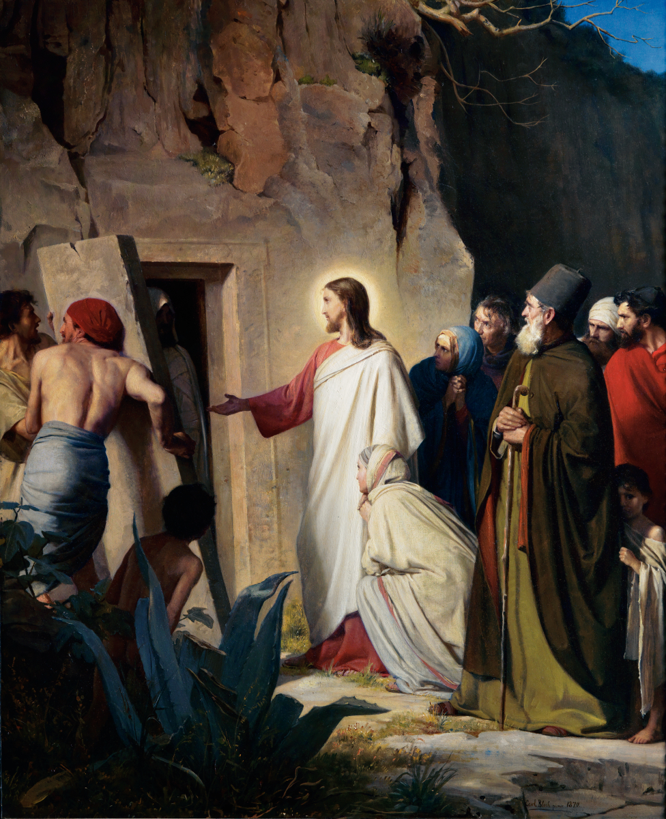
Disciples response
Did they watch him heal the sick? Yes!
Did they watch him calm the sea? Yes!
Did they watch him walk on water? Yes!
Did they watch him raise the daughter of Jarius? Yes!
Did they watch him raise Lazarus from the dead? Yes!
Did he rise from the dead after three days as he said he would?
And [Mary’s] words seemed to [the disciples] as idle tales and they believed [her] not… (Luke 24:11)

Slide 12
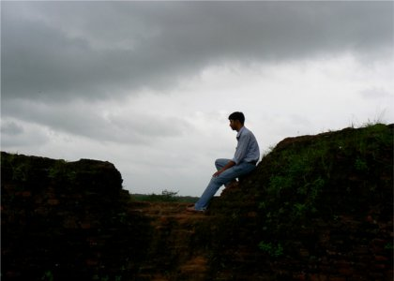
Question:
Where is our “idle tale” line?
Where is the line between actually believing what he said and dismissing his words to us as idle tales?

Slide 13
Amalgamated Version Continued
Then arose Peter, and [I], and came to the sepulcher.
[we] ran both together; and [I] did outrun Peter, and came first to the sepulcher.
And [I], stooping down, and looking in, saw the linen clothes lying; yet went not in.
Then cometh Simon Peter following [me], and went into the sepulcher, and seeth the linen clothes lie, and he departed, wondering in himself at that which was come to pass.
Then [I] went in…, and [I] saw, and believed.
For as yet [we] knew not the Scripture, that he must rise again from the dead.

Slide 14
Skit Guys video

