Slide 1
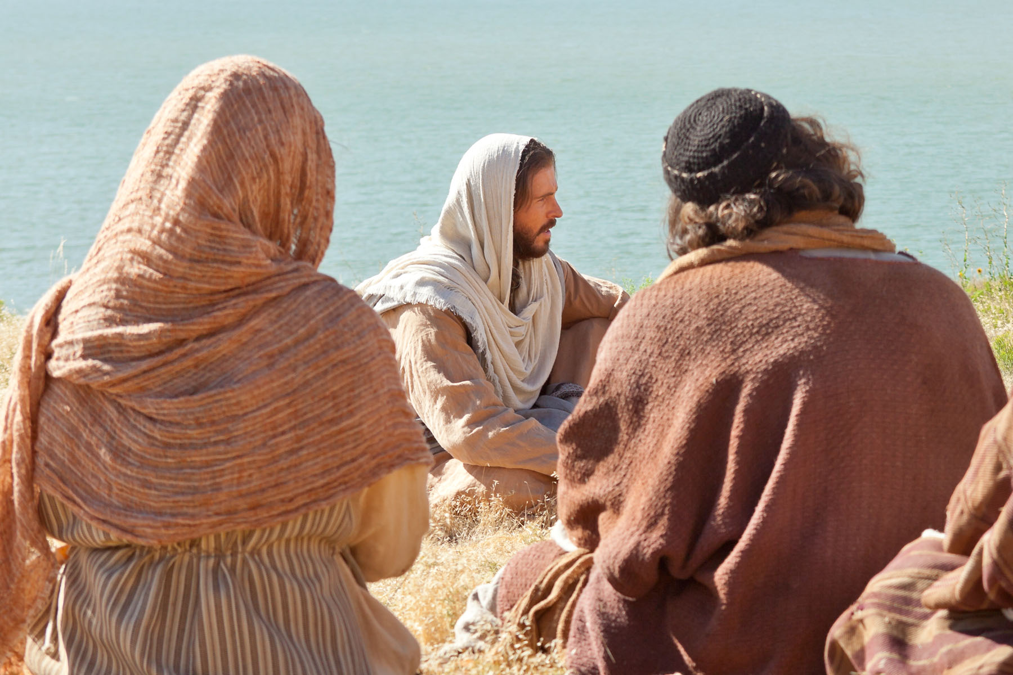
Matthew 6,7

Slide 2
Coke ad, the social media guard

Slide 3
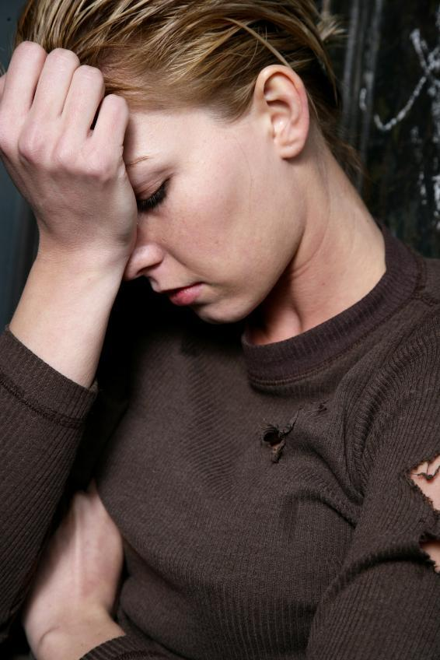
The Tyranny of Fear
Matthew 6:24-34

Slide 4
Catherine Thomas
"In these verses the Lord used the phrase "take no thought for," a bland translation of the Greek word merimnesete, which means to be very anxious about something. He used the word six times in this passage.
In effect he invited us to sacrifice our anxiety over the many elements of our lives that are beyond our control (such as adding a cubit to our stature-- v.27), but that we think affect our well-being.

Slide 6
Catherine Thomas
"In these verses the Lord used the phrase "take no thought for," a bland translation of the Greek word merimnesete, which means to be very anxious about something. He used the word six times in this passage.
In effect he invited us to sacrifice our anxiety over the many elements of our lives that are beyond our control (such as adding a cubit to our stature-- v.27), but that we think affect our well-being.
However, he implied that this sacrifice of fear is possible only if we first give up anger, lust, vengeance, and glory seeking, which in themselves produce fear.
He pointed out that if we make the single aim of our lives the will of God and the promotion of the cause of Zion, those uncontrollable elements of life will, one day at a time, take care of themselves, and we can live knowing that the forces of the universe are working to our benefit.
Matthew 6:34 translates the Greek word kakia as evil. The verse could be accurately translated, 'Do not be unduly anxious about the morrow, for the morrow will take thought for the things of itself; sufficient to the day are the problems (or troubles) thereof'"[2]

Slide 7
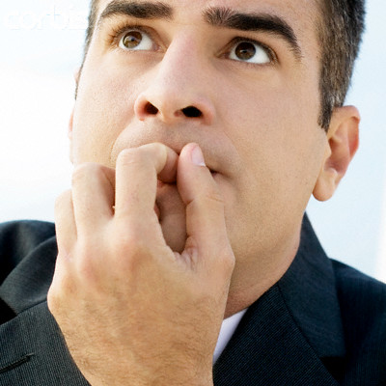
Judging
Matthew 7:1,2
Alma 41:13

Slide 8
Alma 41
13 O, my son…the meaning of the word restoration is to bring back again evil for evil, or carnal for carnal, or devilish for devilish—
good for that which is good; righteous for that which is righteous; just for that which is just; merciful for that which is merciful.
14 Therefore, my son, see that you are:
merciful unto your brethren;
deal justly,
judge righteously,
and do good continually;
and if ye do all these things then shall ye receive your reward;
yea, ye shall have mercy restored unto you again;
ye shall have justice restored unto you again;
ye shall have a righteous judgment restored unto you again;
and ye shall have good rewarded unto you again.

Slide 9
Of Motes and Beams
Matthew 7:3

Slide 10
Ask, Seek, Knock
Matthew 7:7
ASK, and shall be given you;
SEEK, and ye shall find;
KNOCK, and it shall be opened unto you;
For every one that asketh receiveth; and he that seeketh findeth; and to him that knocketh it shall be opened

Slide 11
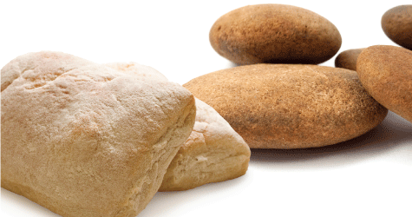
Of Bread and Stones
Matt 6:8
Matt 7:7

Slide 12
Matthew 7:24-26

