Slide 1
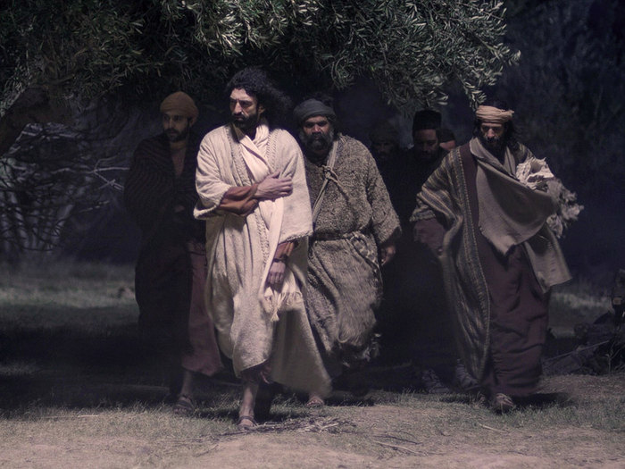
The Sorrows of Gethsemane

Slide 2
Coke Ad

Slide 3
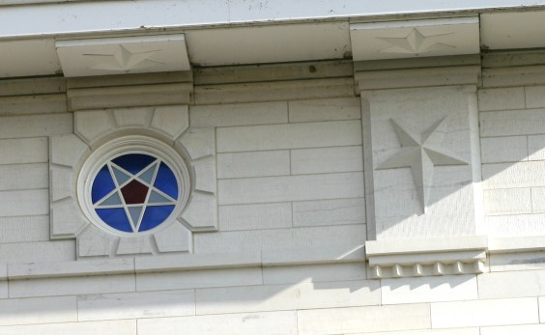
Through the Eyes of Peter
2 Peter 1:15 Moreover I will endeavour that ye may be able after my decease to have these things always in remembrance.
16 For we have not followed cunningly devised fables, when we made known unto you the power and coming of our Lord Jesus Christ, but were eyewitnesses of his majesty…
19 We have also a more sure word of prophecy; whereunto ye do well that ye take heed, as unto a light that shineth in a dark place, until the day dawn, and the day star arise in your hearts:

Slide 4
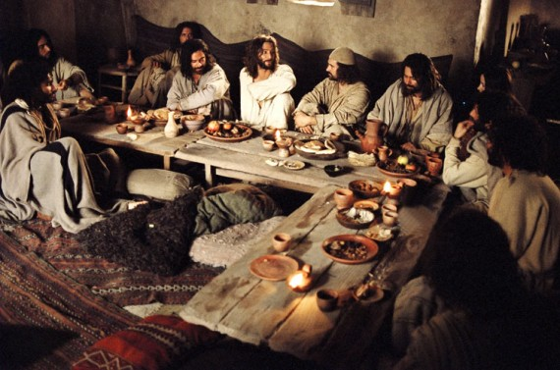
The Hymn
Matt 26:30

Slide 5
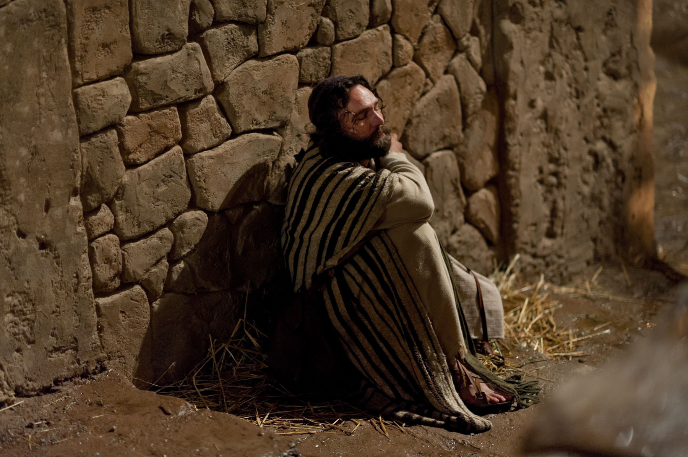
Offended…
Matt 26:31

Slide 6
Elder Holland
In this world we are all, you and I, the man or the woman in the water. We often, like this man and Hamlet, must “take arms against a sea of troubles, and by opposing end them”
And sometimes the cost is very high. It was for Christ, it was for Joseph Smith, and it was for this lone man who counted the cost there in the Potomac—and paid it.
It is not easy to go without—without physical gratifications or spiritual assurances or material possessions—but sometimes we must since there is no guarantee of convenience written into our Christian covenant.
We must work hard and do right, as Abraham Lincoln said, and sometimes our chance will come. And when we’ve tried, really tried, and waited for what seemed never to be ours, then “the angels came and ministered unto him.” For that ministration in your life I pray

Slide 7
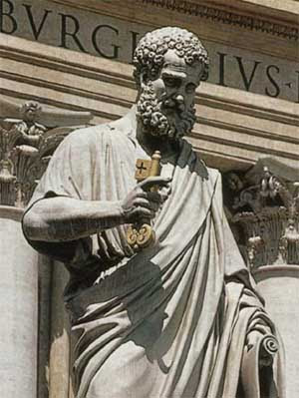
Spencer W. Kimball
Much of the criticism of Simon Peter is centered in his denial of his acquaintance with the Master. This has been labeled “cowardice.”
Are we sure of his motive in that recorded denial? He had already given up his occupation and placed all worldly goods on the altar for the cause. If we admit that he was cowardly and denied the Lord through timidity, we can still find a great lesson.
Has anyone more completely overcome mortal selfishness and weakness? Has anyone repented more sincerely? Peter has been accused of being harsh, indiscreet, impetuous, and fearful. If all these were true, then we still ask, Has any man ever more completely triumphed over his weaknesses?
…Is it possible that there might have been some other reason for Peter’s triple denial? Could he have felt that circumstances justified expediency? When he bore a strong testimony in Caesarea Philippi, he had been told that “they should tell no man that he was Jesus the Christ.”

Slide 8
Gethsemane
Mark 14:26

Slide 9
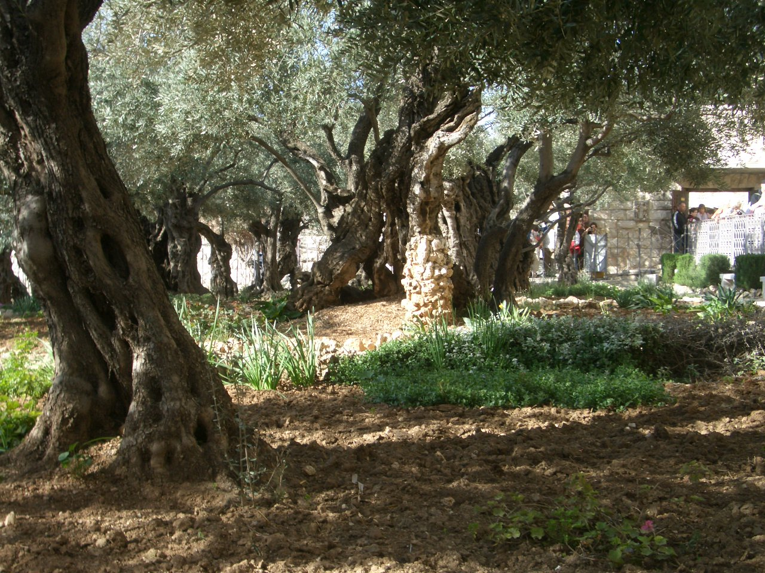
Arranging the Disciples
Matt 26:36

Slide 10
Mt. Sinai Witnesses
Moses Aaron, Nadab, and Abihu 70 Elders
Garden of Gethsemane Witnesses
Jesus Peter, James, and John 8 Apostles
Book of Mormon Witnesses
Joseph Oliver, David, Martin 8 Witnesses

Slide 11
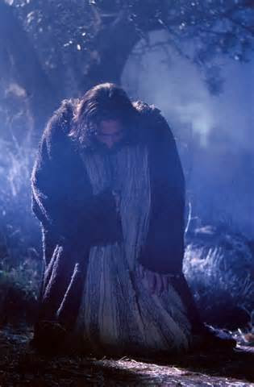
Savior’s Sorrow
Matt 26:39
Luke 22: 43,44

Slide 12
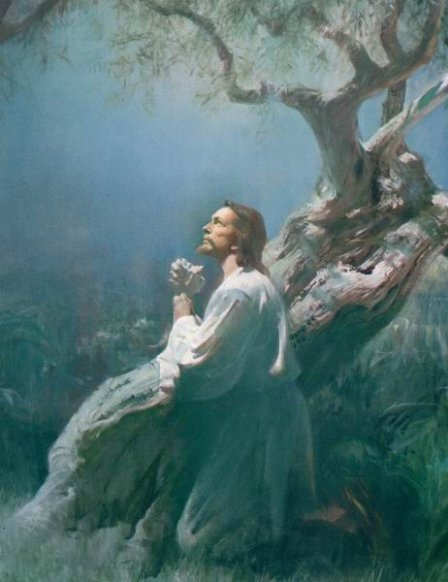
Elder Tad Callister
That he also had godly powers did not make his suffering any less excruciating, any less poignant, or any less real.
To the contrary, it is for this very reason that his suffering was more, not less, than his mortal counterparts could experience. He took upon him infinite suffering, but chose to defend with only mortal faculties,
with but one exception—his godhood was summoned to hold off unconsciousness and death…that would otherwise overpower a mere mortal when he reached his threshold of pain.
For the Savior, however, there would be no such relief. His divinity would be called upon, not to immunize him from pain, but to enlarge the receptacle that would hold it.
He simply brought a larger cup to hold the bitter drink.
(Infinite Atonement, p. 119)

Slide 13
Elder Holland Video (Alone)

Slide 14
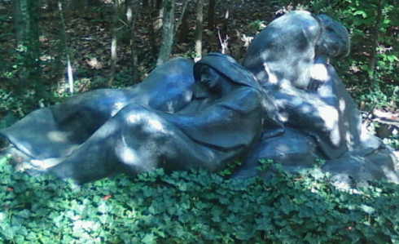
Sleeping for Sorrow
Matt 26:40
Mark 13:32-37

Slide 15
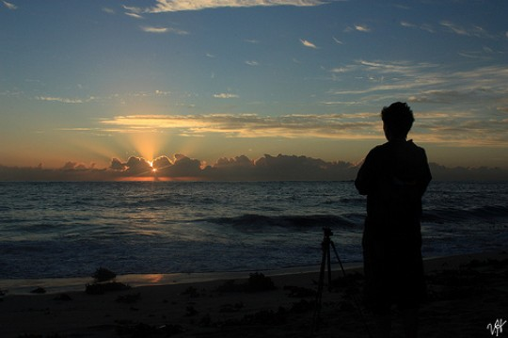
Principle
Sorrow we must,
but do we sleep or watch?

