Slide 1
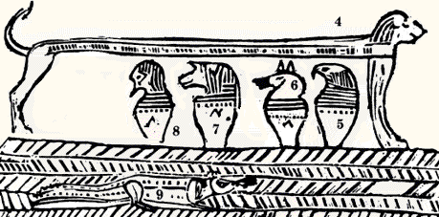
Joseph and Moses

Slide 2
Princess Bride Video

Slide 3
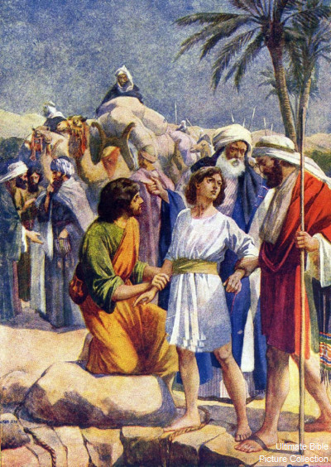
Forgiveness
Genesis 50: 15-21

Slide 4
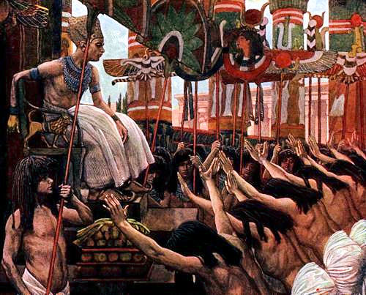
Joseph’s Last Dream…
Genesis 50:15

Slide 5
Joseph Smith Patriarchal Blessing
I bless thee with the blessings of thy fathers Abraham, Isaac and Jacob; and…thy father Joseph, the son of Jacob. Behold, he looked after his posterity in the last days, when they should be scattered and driven by the Gentiles, and wept before the Lord;
he sought diligently to know from whence the Son should come who should bring forth the word of the Lord, by which they might be enlightened, and brought back to the true fold, and his eyes beheld thee, my son;
…and he said, As my blessings are to extend to the utmost bounds of the everlasting hills; as my father's blessing prevailed, over the blessings of his progenitors, and as my branches are to run over the wall, and my seed are to inherit the choice land whereon the Zion of God shall stand in the last days, from among my seed, scattered with the Gentiles,
shall a choice Seer arise, whose bowels shall be a fountain of truth, whose loins shall be girded with the girdle of righteousness, whose hands shall be lifted with acceptance before the God of Jacob to turn away his anger from his anointed, whose heart shall meditate great wisdom, whose intelligence shall circumscribe and comprehend the deep things of God, and whose mouth shall utter the law of the just…and he shall feed upon the heritage of Jacob his father [Utah Genealogical and Historical Magazine 23 (Oct. 1932):175].

Slide 6
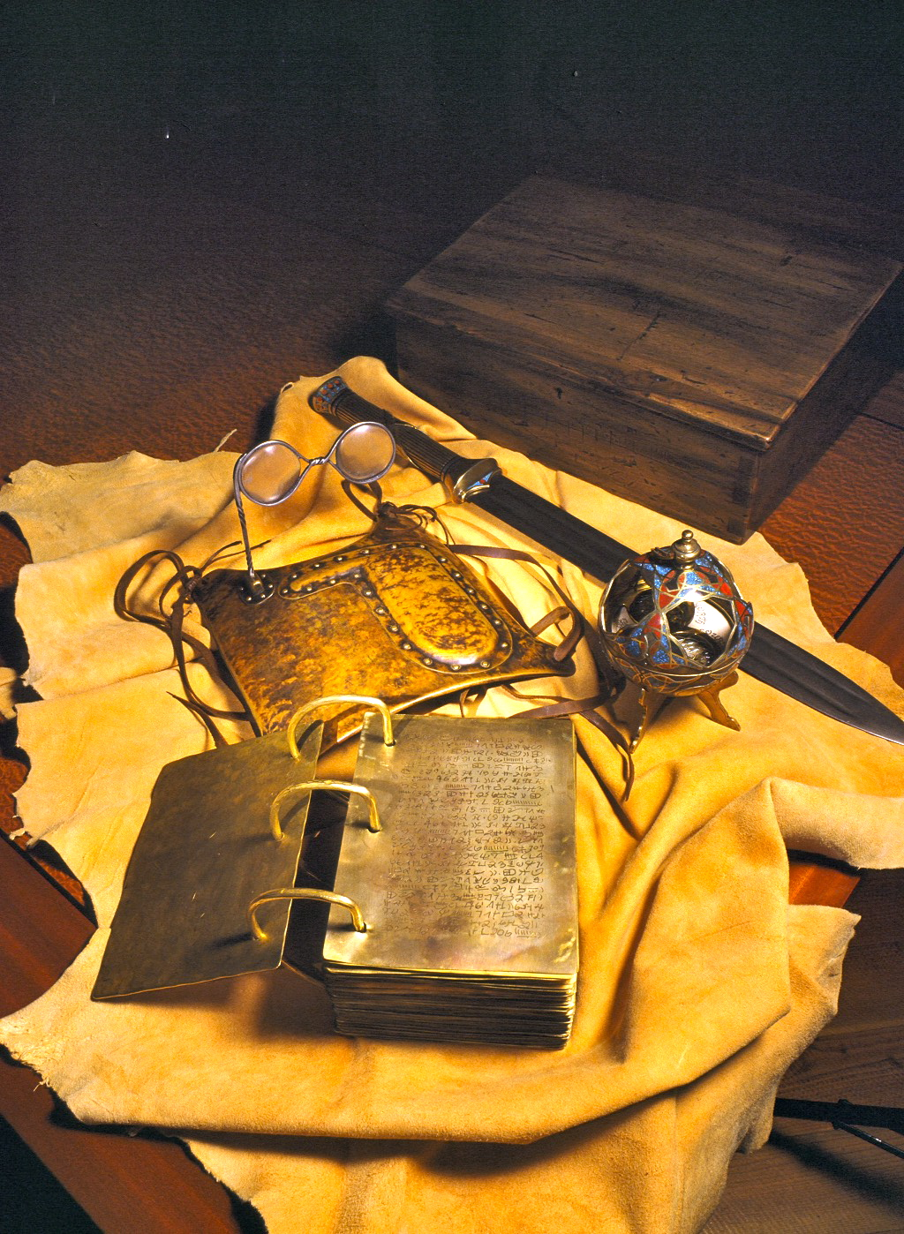
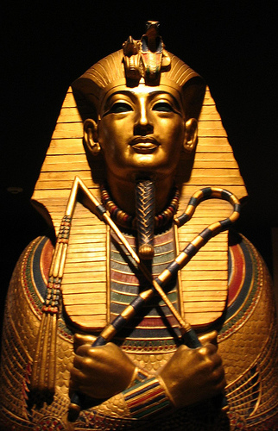
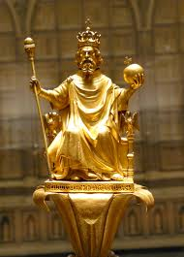
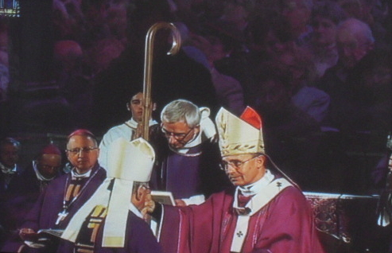

Slide 7
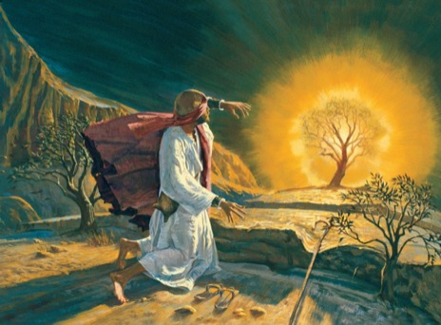
Moses
Exodus 2
Exodus 4

