Slide 1
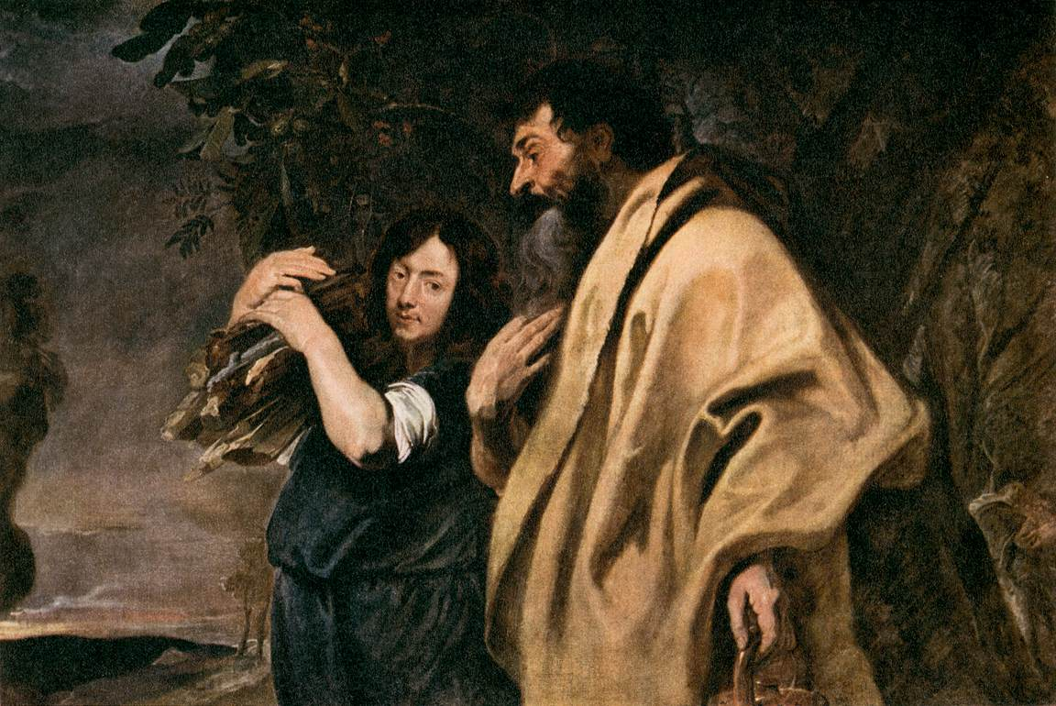
Abraham and Isaac

Slide 2
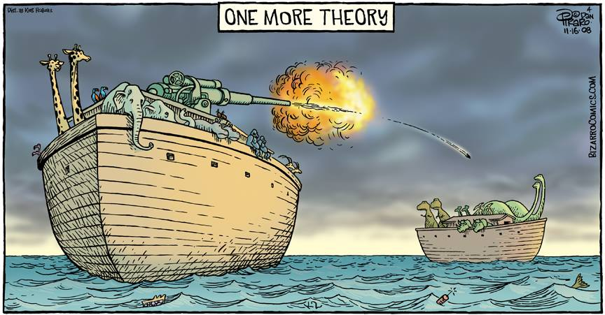

Slide 3
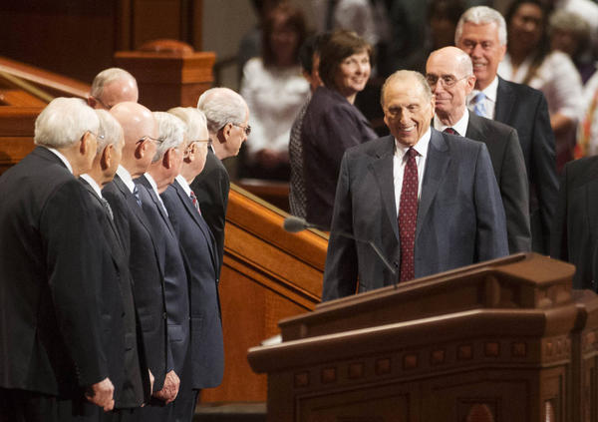
General Conference

Slide 4
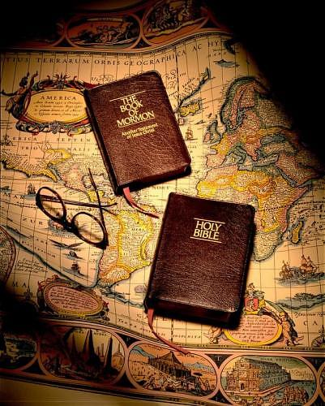
Question
How did we get the content of the Book of Mormon
How did we get the content of the Old Testament?

Slide 5
Hugh Nibley

Slide 6
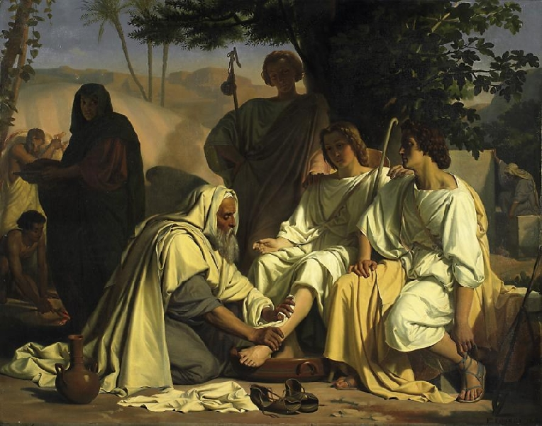
abraham
Genesis 18

Slide 7
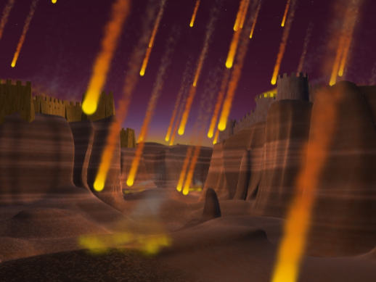
Lot and Sodom
Genesis 19

Slide 8
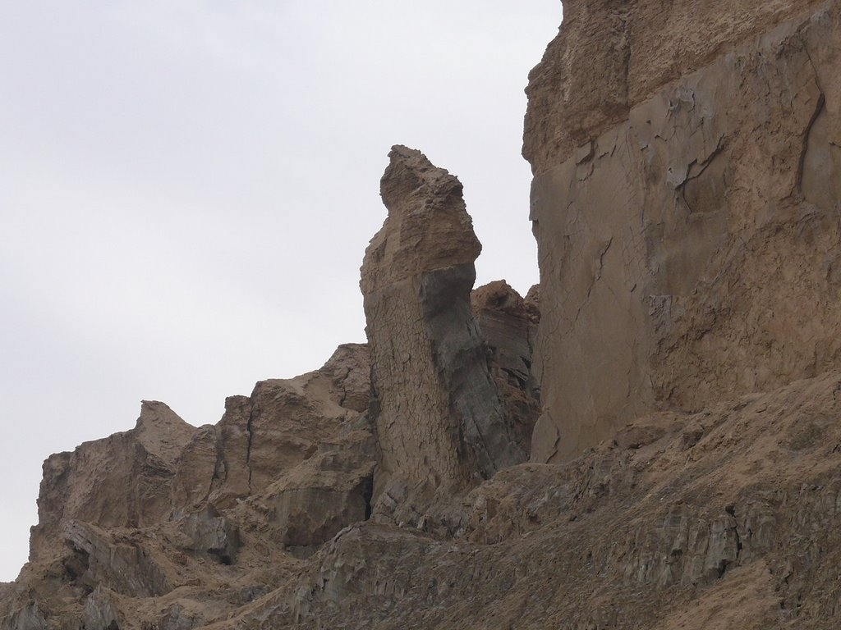
Lot’s Wife
Luke 17:29-33

Slide 9
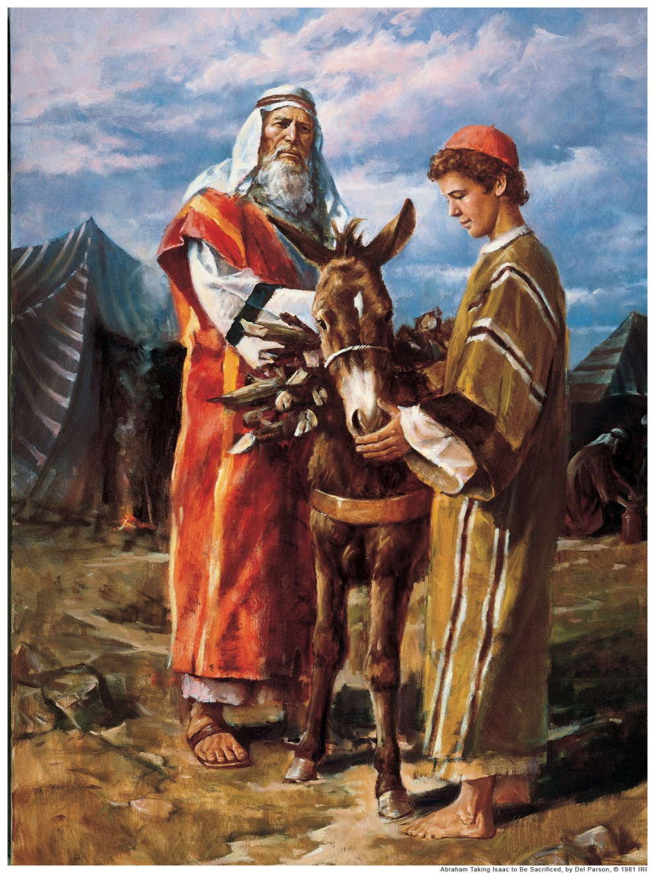
The Great Sacrifice
Genesis 22

