Slide 1
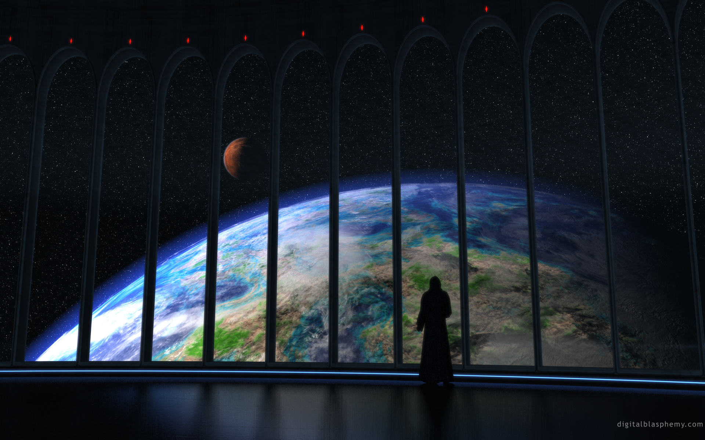
The Creation

Slide 2
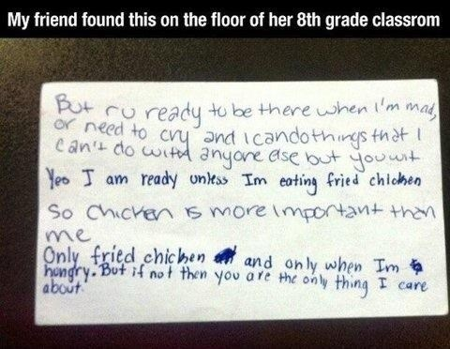
8th Grade Friends

Slide 3
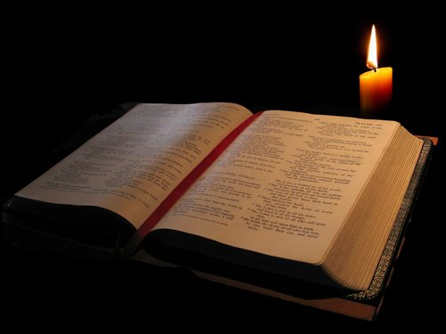
Study Aids
Blueletterbible.org
Gospeldoctrine.com
Google and Thummin

Slide 4
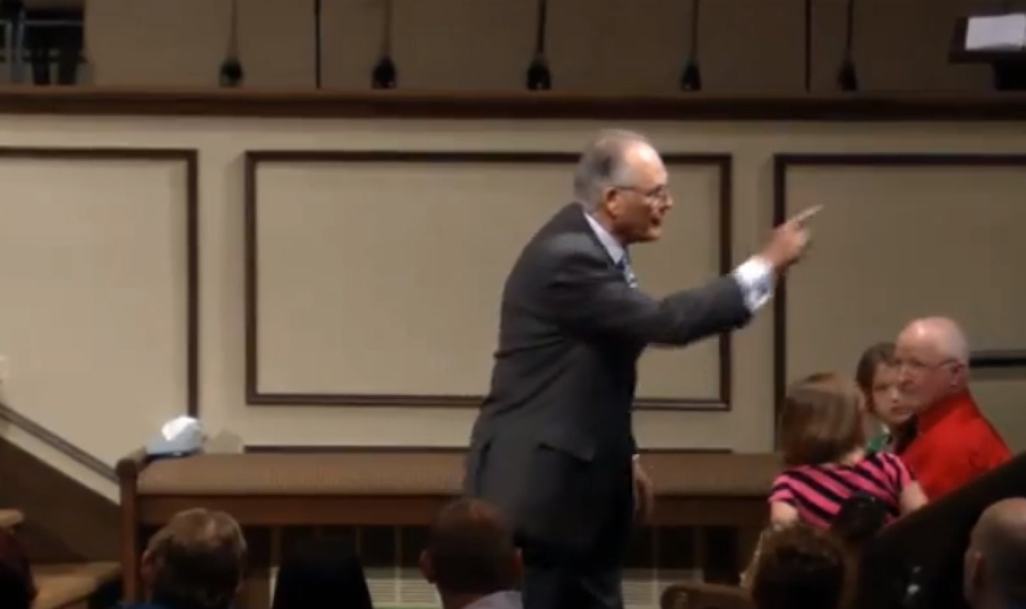
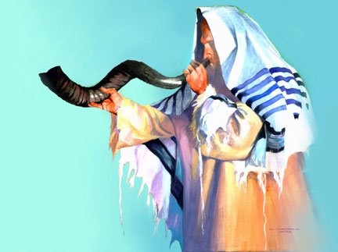
First Question
Is the Church more Jewish or more Christian?

Slide 5
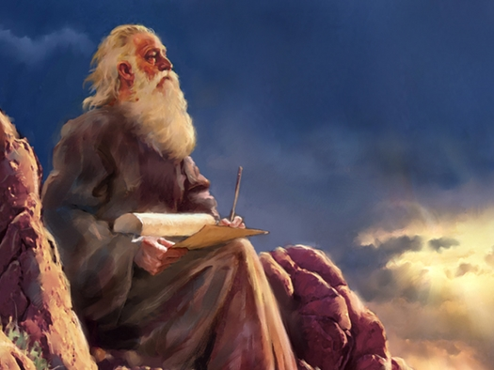
The Question….
Moses 1:25

Slide 6
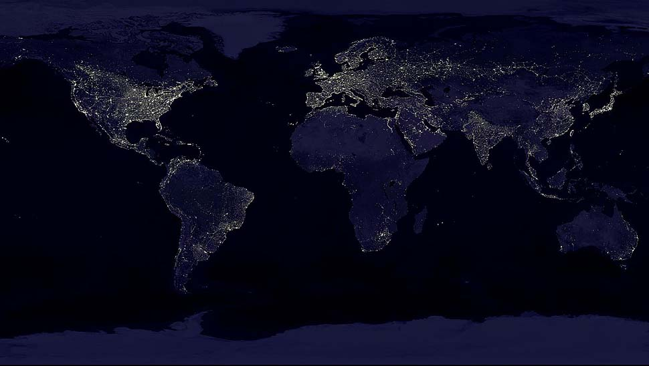
Moses’ Grand Calling
Moses 1:26,27

Slide 7
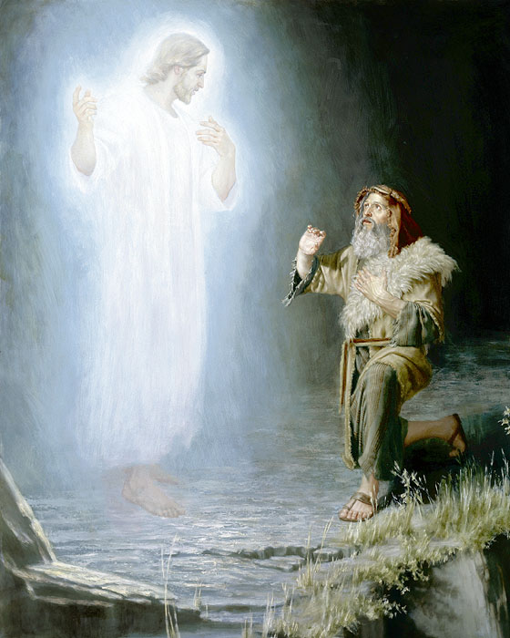
Question
What does “face to face” mean?

Slide 8
The Answer
Moses 1: 39
The Celestial Glory Cycle
D&C 81:4

Slide 9
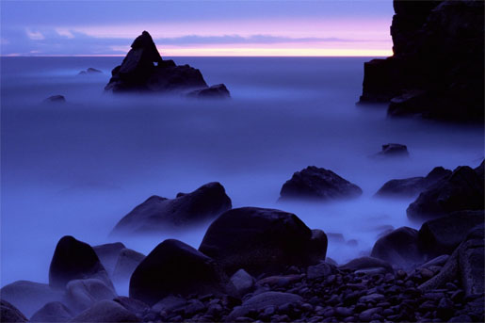
The Creation
Genesis 1: 1,2

Slide 10
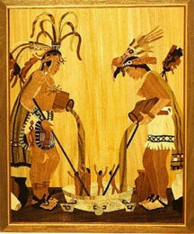
Ultimate Creation
Genesis 1:26,27
Moses 6:63-65

Slide 11
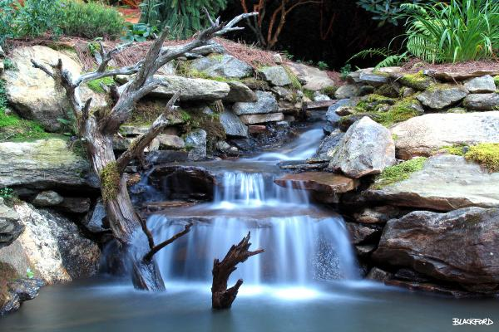
Where was the Garden of Eden
Genesis 1:9,10

