Slide 1
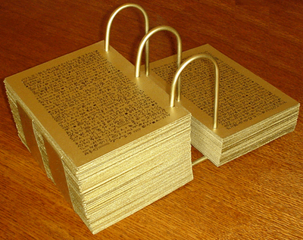
Section 84 Part II
www.kevinhinckley.com

Slide 2
Additional Lyrics
I am a child of God
That’s only half the view
If I don’t shed the natural man
I’m lost, and so are you.
Lead me guide me, reconcile me
Chasten me on earth;
Help me overcome the fall;
Grant me second birth

Slide 3
I am a child of God
But that doesn’t clear the slate
I’m carnal, sensual, devilish, too
In a lost and fallen state
Save me, change me, rearrange me,
Gracious God above:
Cleave unto my broken heart
Bestow redeeming love.

Slide 4
I am a child of God
Yet I’ve become his child
Through faith in his Beloved Son’s
Redemption undefiled.
Lead me, guide me, justify me,
Cleanse me, make me pure;
Help me love as thou hast loved,
Or I cannot endure.
Paul Sutorius, Curtis Wright

Slide 5
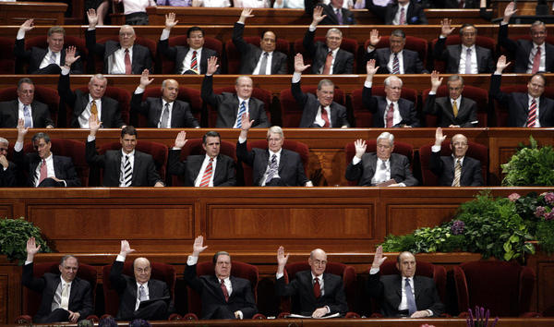
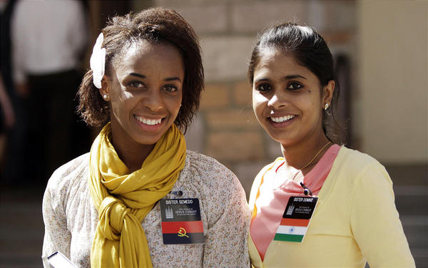

Slide 6
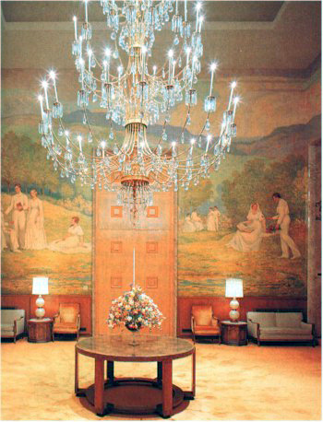
The Preparatory Gospel (Review)
D&C 84: 20-27

Slide 7
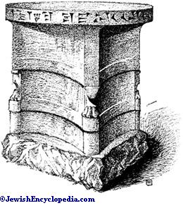
Sacrifice
D&C 84:31

Slide 8
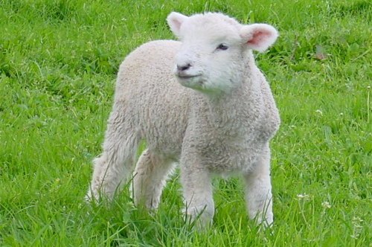
Joseph Smith
It is generally supposed that sacrifice was entirely done away when the Great Sacrifice (i.e., the sacrifice of the Lord Jesus) was offered up, and that there will be no necessity for the ordinance of (animal) sacrifice in the future: but those who assert this are certainly not acquainted with the duties, privileges and authority of the Priesthood, or with the prophets. . . .
These sacrifices, as well as every ordinance belonging to the Priesthood, will, when the Temple of the Lord shall be built, and the sons of Levi purified, be fully restored and attended to in all their powers, ramifications, and blessings.
It is not to be understood that the Law of Moses will be established again with all its rites and variety of ceremonies; this has never been spoken of by the prophets; but those things which existed prior to Moses' day, namely, sacrifice will be continued.
(History of the Church, 4:211)

Slide 9
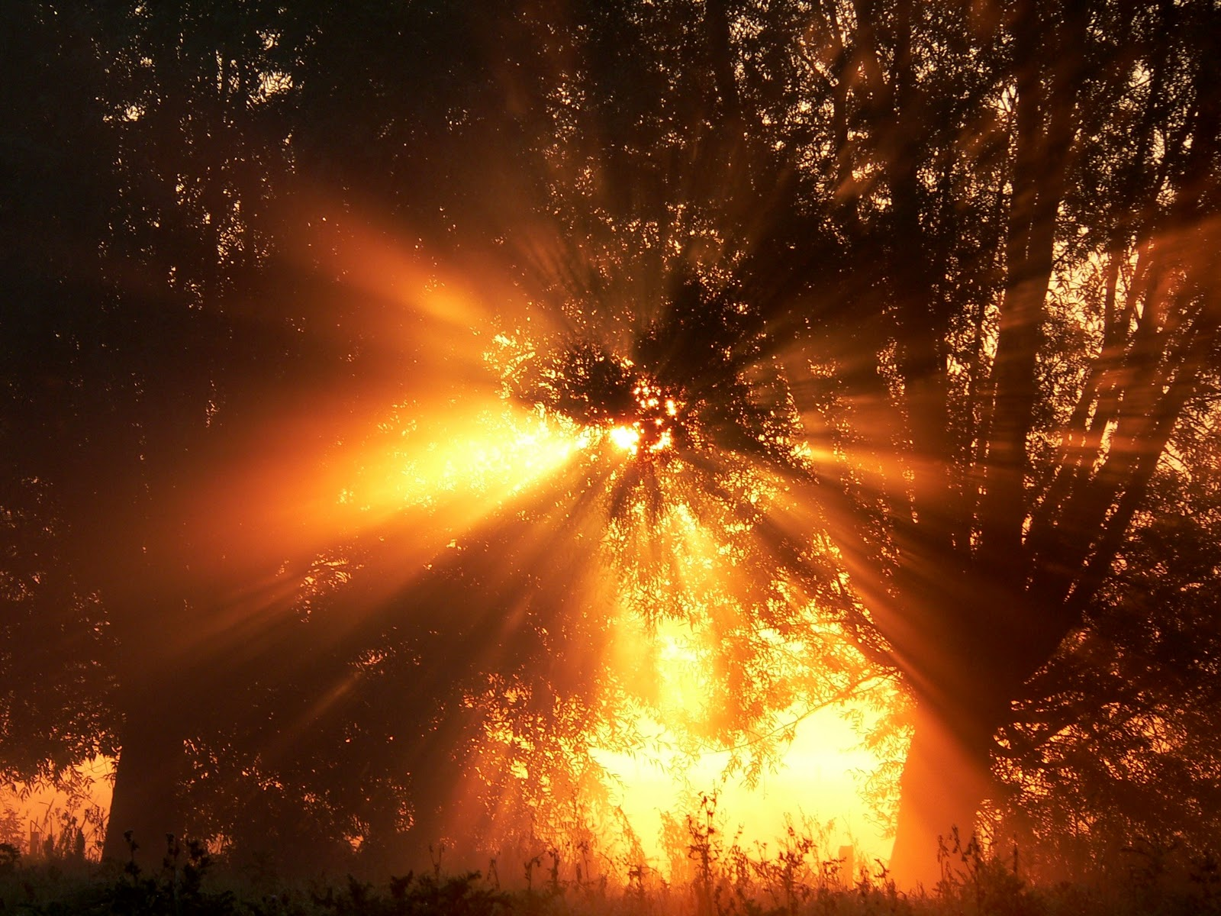
Light and Condemnation
D&C 84: 45-55

Slide 10
Elder Oaks, 1994
A few years ago I received a letter from a man who said he had attended an LDS testimony meeting and listened to seventeen testimonies without hearing the Savior mentioned or referred to in any way. He also wrote that the following Sunday he listened to a priesthood lesson, a Gospel Doctrine lesson, and seven sacrament meeting speakers without hearing any reference to Jesus Christ
In too many of our classes, in too many of our worship services, we are not teaching of Christ and testifying of Christ in the way we should. This is one way we are failing to “remember the new covenant.”
A prominent gospel scholar saw this deficiency in our Church periodicals published in a 23-year period ending in 1983…
I saw this same deficiency when I reviewed the subjects of general conference addresses during the decade ending in the mid-1980s.
Another illustration is provided by some Latter-day Saint funerals. I attend some funerals and hear reports of many others. Worthy tributes to the deceased are appropriate, and so are family memories. But such matters must not dominate an LDS funeral service to the exclusion or neglect of those gospel truths that review the purpose of life and testify of our Creator and Redeemer.

Slide 11
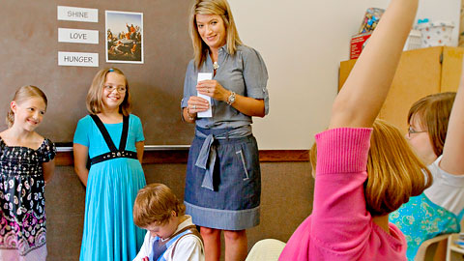
Discipleship Hints
Hint #1
D&C 84:88

Slide 12
Discipleship Hints
Hint #2
D&C 84:106

