Slide 1
The New and Everlasting Covenant
D&C 132

Slide 2
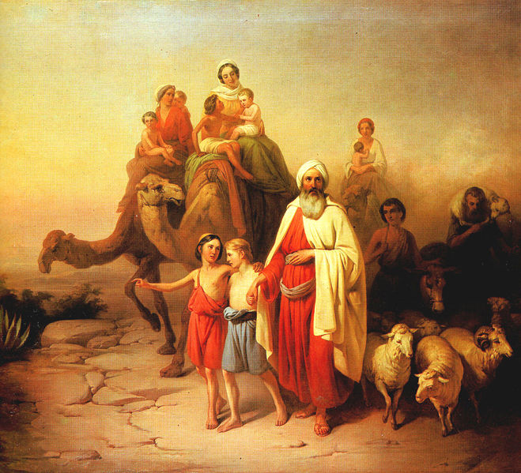
While Revising the Bible
D&C 132:1

Slide 3
William Clayton
"... On the morning of the 12th of July, 1843; Joseph and Hyrum Smith came into the office in the upper story of the brick store, on the bank of the Mississippi river. They were talking on the subject of plural marriage. Hyrum said to Joseph,
'If you will write the revelation on celestial marriage, I will take it and read it to Emma, and I believe I can convince her of its truth, and you will hereafter have peace.' Joseph smiled and remarked, 'You do not know Emma as well as I do.'
Hyrum repeated his opinion, and further remarked, 'The doctrine is so plain, I can convince any reasonable man or woman of its truth, purity and heavenly origin,' or words to that effect. Joseph then said, 'Well, I will write the revelation and we will see.'
He then requested me to get paper and prepare to write. Hyrum very urgently requested Joseph to write the revelation by means of the Urim and Thummim, but Joseph in reply, said he did not need to, for he knew the revelation perfectly from beginning to end.
"Joseph and Hyrum then sat down and Joseph commenced to dictate the revelation on celestial marriage, and I wrote it, sentence by sentence, as he dictated. After the whole was written, Joseph asked me to read it through, slowly and carefully, which I did, and he pronounced it correct. He then remarked that there was much more that he could write on the same subject, but what was written was sufficient for the present.
History of The Church of Jesus Christ of Latter-day Saints, 7 vols., introduction and notes by B. H. Roberts [Salt Lake City: The Church of Jesus Christ of Latter-day Saints, 1932-1951], 5: xxix-xxxiv.)

Slide 4
What We Know
Revelation first received in 1831
Joseph didn’t act until around 1836 (Fanny Alger)
Joseph, as a prophet, had to know the consequences plural marriage on himself and the church
Joseph felt caught between an angel with drawn sword and Emma

Slide 5
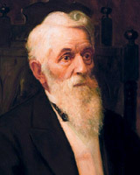
Prophet Lorenzo Snow
"The Prophet Joseph Smith there and then explained to me the doctrine of plurality of wives; he said that the Lord had revealed it unto him, and commanded him to have women sealed to him as wives;
that he foresaw the trouble that would follow, and sought to turn away from the commandment;
That an angel from heaven then appeared before him with a drawn sword, threatening him with destruction unless he went forward and obey the commandment."
"He further said that my sister, Eliza R. Snow, had been sealed to him as his wife for time and eternity. …This conversation was prolonged, I think, one hour or more, in which he told me many important things."
"I solemnly declare before God and holy angels, and as I hope to come forth in the morning of the resurrection, that the above statement is true." - Prophet Lorenzo R. Snow, sworn affidavit.

Slide 6
What We Know
Revelation first received in 1831
Joseph didn’t act until around 1836 (Fanny Alger)
Joseph, as a prophet, had to know the consequences plural marriage on himself and the church
Joseph felt caught between an angel with drawn sword and Emma
Emma emotionally swung widely in response
Joseph always went to a family member to ask for permission
Actual amount of women he was sealed to is unknown….
Abrahamic-like test for almost all
Like the law of consecration, plural marriage was sometimes lived well, often very painfully.

Slide 7
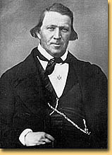
For Instance
When Brigham and others of the Twelve returned to Nauvoo from England in July 1841, Joseph began immediately to teach them the new doctrine of marriage. Only this time he brought the concept of plural marriage together with eternal marriage into what would become known as 'celestial' or patriarchal' marriage.
In looking back on the occasion, Brigham Young said, 'It was the first time in my life that I had desired the grave, and I could hardly get over it for a long time.'
Heber C. Kimball begged Joseph 'to remove the requirement' or he would leave the church.
And John Taylor indicated that the Twelve 'seemed to put off as far as we could, what might be termed the evil day' when they would take plural wives…
…Joseph Lee Robinson commented, 'It could not be expected that they could enter into this new order of things without difficulty and some severe trials for it is calculated in its nature to severely try the women, to nearly tear their heart strings out of them, and also it must severely try the men as well.'

Slide 8
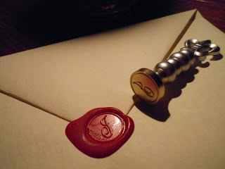
D&C 132:7
All
Oaths
Vows
Performances
Connections
Associations
Expectations
Of Him
Anointed
By Revelation
And Commandment

Slide 9
Question…
What must we do to make a marriage sealed with the Promise?

Slide 10
Time?
Failing to understand the nature of mortality with its earthly experiences causes some couples to expect a celestial marriage after making only a short-term, telestial investment- perhaps the ultimate example of a “get-rich-quick scheme.
When the anticipated returns on their investment don’t materialize or when the market drops, they are tempted, or even threaten, to sell out. They take counsel from their fears, their frustrations, and their partner’s failings.
Couples must understand that a celestial marriage comes only “in process of time.” Even for remarkable Enoch, it required 365 years, to transform people whose “hearts had waxed hard…whose ears were dull of hearing, and whose eyes could not see afar off”
into a community of people who were of one heart and one mind and who dwelt in righteousness…
Kent Brooks, Ministering in Marriage, (Living a Covenant Marriage, 2004)

Slide 11
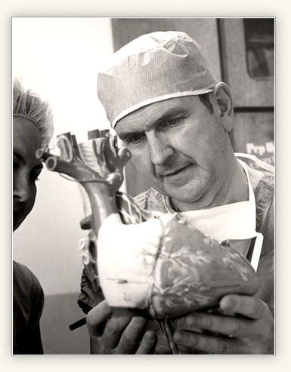
Elder Russel M. Nelson

