Slide 1
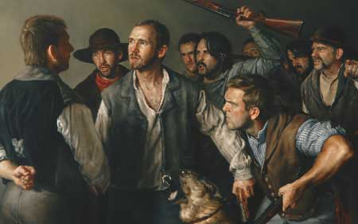
Deep Water D&C 127 and 128

Slide 2
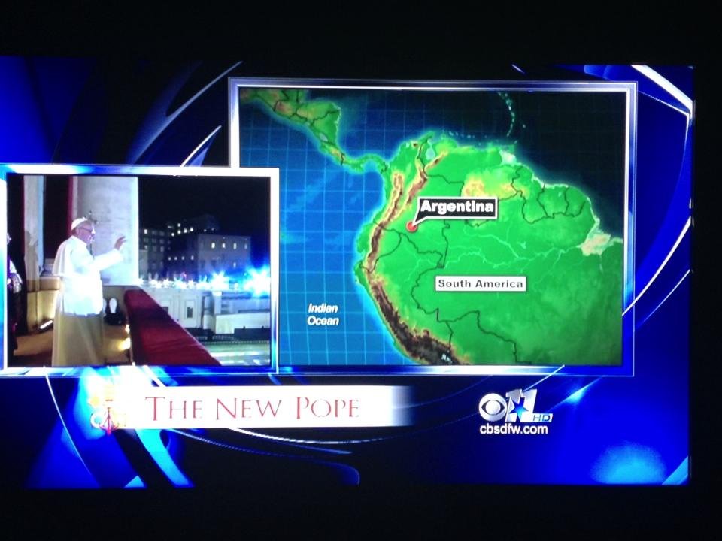
Local News- The People to Trust…

Slide 3
Times and Seasons
The great designs of God in relation to the salvation of the human family, are very little understood by the professedly wise and intelligent generation in which we live...
The Mussulman (Muslim) condemns the heathen, the Jew, and the Christian, and the whole world of mankind that reject his Koran, as infidels, and consigns the whole of them to perdition. The Jew believes that the whole world that rejects his faith and are not circumcised, are Gentile dogs, all will be damned.
The heathen is equally as tenacious about his principles, and the Christian consigns all to perdition who cannot bow to his creed, and submit to his ipse dixit (notion that "I have said it, therefore it is true.")
But while one portion of the human race is judging and condemning the other without mercy, the Great Parent of the universe looks upon the whole of the human family with a fatherly care and paternal regard; He views them as His offspring, and without any of those contracted feelings that influence the children of men, [He] causes "His sun to rise on the evil and on the good, and sendeth rain on the just and on the unjust."
He holds the reins of judgment in His hands; He is a wise Lawgiver, and will judge all men, not according to the narrow, contracted notions of men, but, "according to the deeds done in the body whether they be good or evil," or whether these deeds were done in England, America, Spain, Turkey, or India.
He will judge them, "not according to what they have not, but according to what they have," those who have lived without law, will be judged without law, and those who have a law, will be judged by that law. We need not doubt the wisdom and intelligence of the Great Jehovah; He will award judgment or mercy to all nations according to their several deserts...

Slide 4
Reminder
D&C 58: 2-4

Slide 5
Tribulation
D&C 127

Slide 6
Question
How do we comfort those that stand in need of comfort?

Slide 7
The Mourning Booth

Slide 8
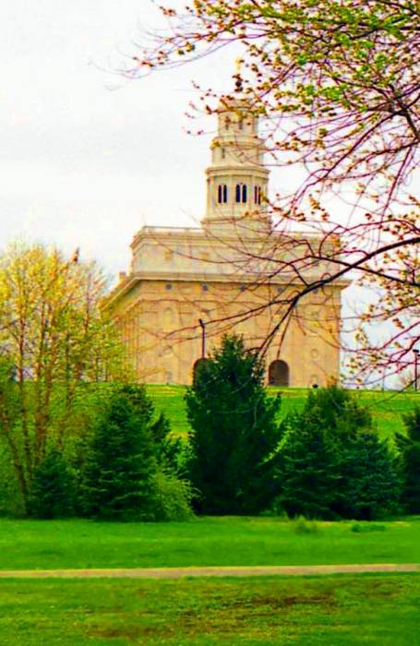
Still in Hiding
Edward Hunter Home
D&C 128

Slide 9
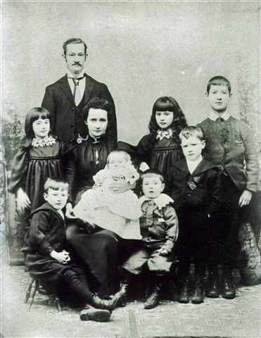
The Perfecting Link
D&C 128:18

Slide 10
Michael Wilcox
"In September 1842, the Prophet Joseph Smith was hiding in the house of Edward Hunter in Nauvoo... Yet it was in the cramped quarters of Edward Hunter's home that Joseph penned the most majestic hymn of praise of the Restoration.
"Perhaps you have been to a symphony and listened to a piece of music that begins with a single, clear note played by a violin or a flute. The single instrument holds center stage for a time and then slowly, sometimes almost imperceptibly, is joined by other instruments. As the piece continues, the music swells as more and more instruments join in until all are playing and the whole hall is filled with the beauty of sound.
"This is the structure of Joseph Smith's hymn of praise, only it is a hymn not of voice in song or note of violin but in words played upon the soul and recorded in the scriptures. Joseph's hymn, too, begins with a single voice, 'a voice of gladness.' Listen to the words and see if you can hear the other voices join in to sing one unified song of praise for the blessings of the Restoration…

Slide 11
Celestial Joy
D&C 128:19

