Slide 1
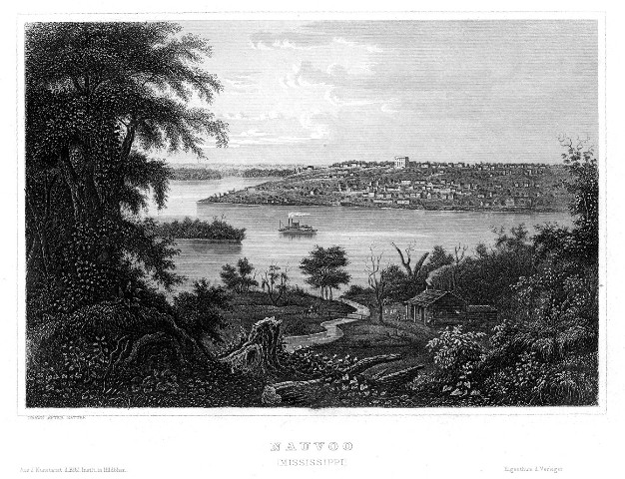
The City Beautiful

Slide 2
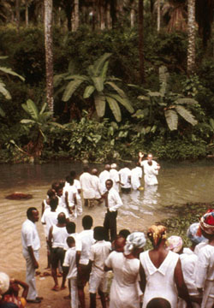
New Introduction to Official Declaration 2:
The Book of Mormon teaches that “all are alike unto God,” including “black and white, bond and free, male and female” (2 Nephi 26:33). Throughout the history of the Church, people of every race and ethnicity in many countries have been baptized and have lived as faithful members of the Church.
During Joseph Smith’s lifetime, a few black male members of the Church were ordained to the priesthood. Early in its history, Church leaders stopped conferring the priesthood on black males of African descent.
Church records offer no clear insights into the origins of this practice. Church leaders believed that a revelation from God was needed to alter this practice and prayerfully sought guidance.
The revelation came to Church President Spencer W. Kimball and was affirmed to other Church leaders in the Salt Lake Temple on June 1, 1978. The revelation removed all restrictions with regard to race that once applied to the priesthood.

Slide 3
Looking towards Easter

Slide 4
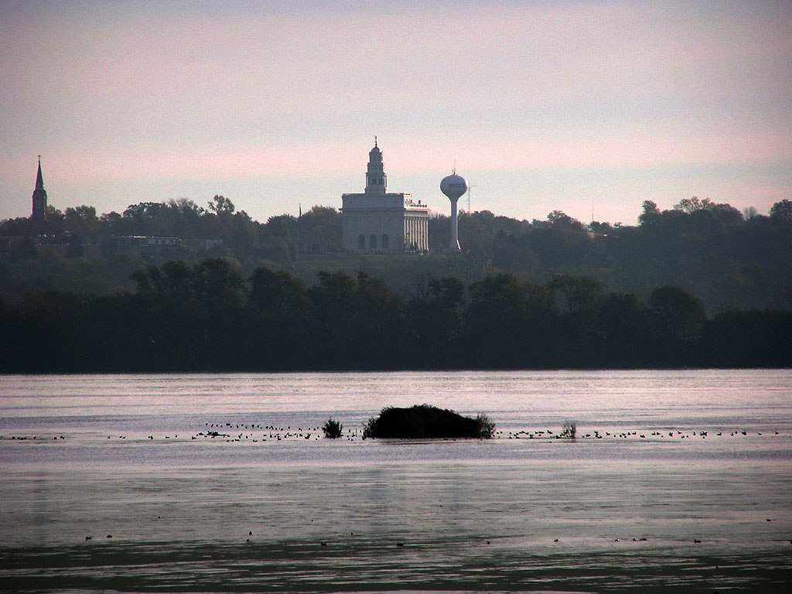
Nauvoo
Isaiah 52:7
Purchased from Isaac Galland

Slide 5
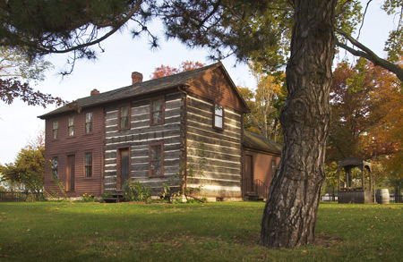

Slide 6
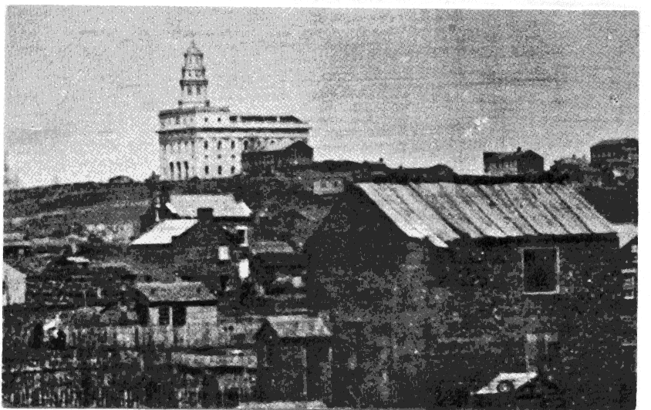

Slide 7
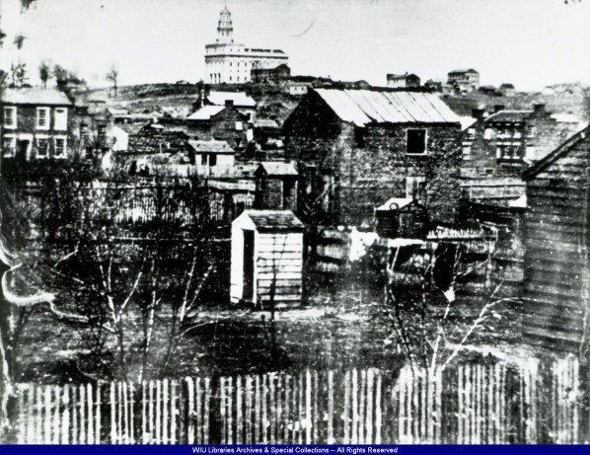

Slide 8
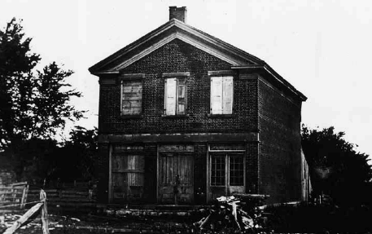

Slide 9
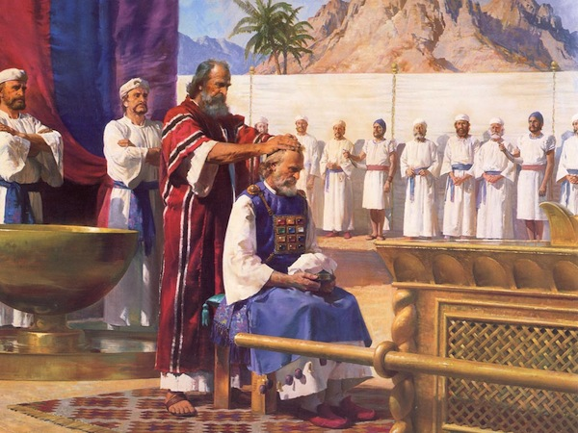
Doctrinal Developments
Ann Taves:
…direct inspiration survives only when it is supported by a sacred mythos embedded in sacred practices….
Rough Stone Rolling

Slide 10
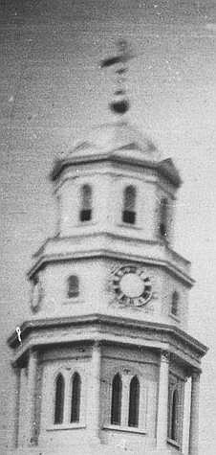
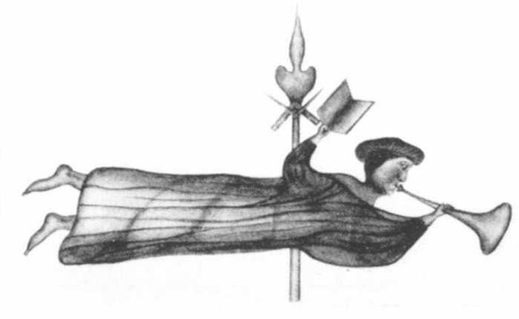
Joseph Smith and Freemasonry
Advantages of Mormon/Masonry
June 1841 First Lodge
March 15th 1842, Installation of new members
March 16th, Joseph becomes “master mason”
March 30th, Organization of the Relief Society
First Endowment bestowed May 4th, 1842
Masonic Hall, April 1844
Joseph Smith:
Freemasonry was taken from priesthood but has become degenerated. But many things are perfect.

Slide 11
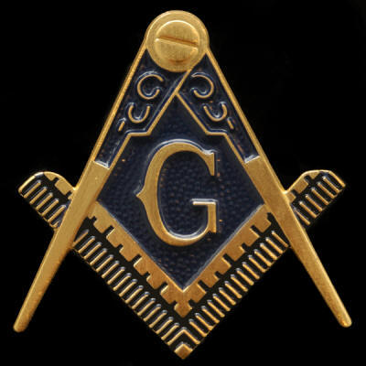
Differences
Masonry
Focus is on the Temple of Solomon
Fraternity
Worshipful Master
Bound to one another
Temple
Focus is on Creation
Exaltation
God and Christ
Bound to God
Entering into God’s presence

Slide 12
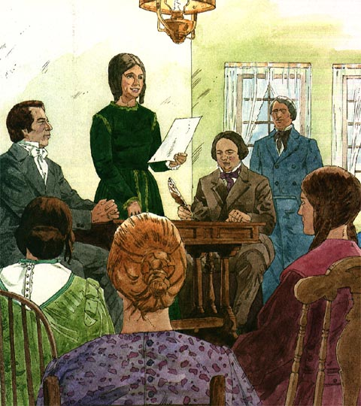
Relief Society
Sarah Kimball
March 2, 1842

Slide 13
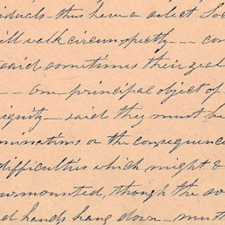
Relief Society, March 30th
we must obey that voice, observe the Constitution that the blessings of heaven may rest down upon us—
all must act in concert or nothing can be done—
that the Society should move according to the ancient priesthood
hence there should be a select Society separate from all the evils of the world, choice, virtuous and holy—
Said he was going to make of this Society a kingdom of priests as in Enoch’s day— as in Pauls day —
that it is the privilege of each member to live long [

Slide 14
BYU Religious Studies Center
As late as 1878, for instance, Eliza R. Snow, meeting with members of the Spring City, Utah, ward Relief Society:.
“Joseph organized a female relief society according to the commandment of God,” the minutes reported; “his wife Emma was pres and she [Eliza] was secretary; some thought that the bretheren would save us and we had nothing to do but this was not the case
we had just as much to do as they had and had as great labor to do and would receive just as much blessings.”
As assertion of female moral agency and accountability, Joseph Smith’s admonition led women to a path of spiritual maturity and independence in making choice for themselves and accepting responsibility for their own spiritual progression.

Slide 15
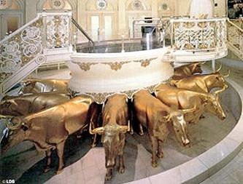
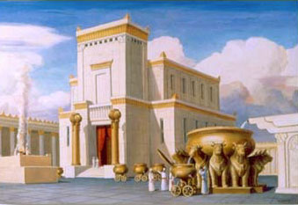
Baptisms for the Dead
Funeral of Seymour Brunson
-10 Aug 1940
-Jane Nyman, then baptized for her son Cyrus
D&C 124:26-29

