Slide 1
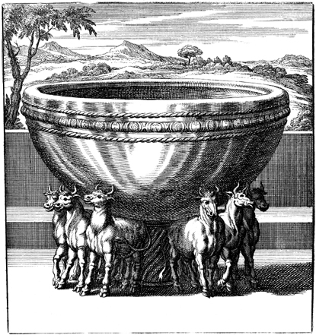
Places of Refuge

Slide 2
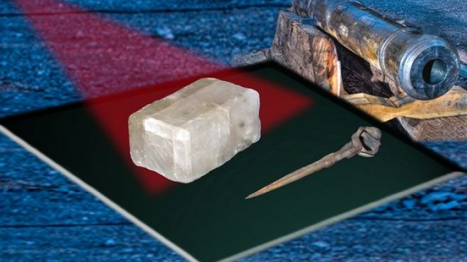
France….
Ancient lore has suggested that the Vikings used special crystals to find their way under less-than-sunny skies. Though none of these so-called "sunstones" have ever been found at Viking archaeological sites, a crystal uncovered in a British shipwreck could help prove they did indeed exist.
If you were to look at someone's face through a clear chunk of Icelandic spar, you would see two faces.
A chemical analysis confirmed that the stone was Icelandic Spar, or calcite crystal, believed to be the Vikings' mineral of choice for their fabled sunstones, mentioned in the 13th-century Viking saga of Saint Olaf.
Because of the shape of calcite crystals, "they refract or polarize light in such a way to create a double image This means that if you were to look at someone's face through a clear chunk of Icelandic spar, you would see two faces. But if the crystal is held in just the right position, the double image becomes a single image and you know the crystal is pointing east-west…
European seafarers had not fully figured out magnetic compasses for navigation until the end of 16th century. The researchers say the crystal might have been used on board the Elizabethan ship to help correct for errors with a magnetic compass

Slide 3
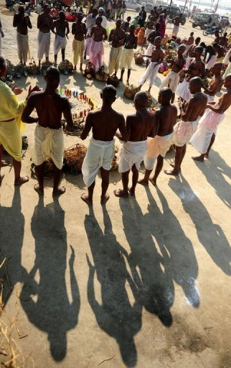
India
The world's biggest religious festival concluded on Sunday with nearly two million pilgrims taking a dip in an Indian holy river that washed away the sins of 120 million people in the last 60 days.
The Kumbh Mela, celebrated every 12 years at the conjunction of two sacred rivers on the outskirts of the northern Indian city of Allahabad, drew massive crowds of devotees, ascetics and foreign tourists.
The two-month-long Kumbh Mela ended on the occasion of a major Hindu festival celebrated across India and Nepal.
Authorities at the festival on Sunday said the last batch of holy men marked the end of the Kumbh by plunging into the river Ganges ….

Slide 4
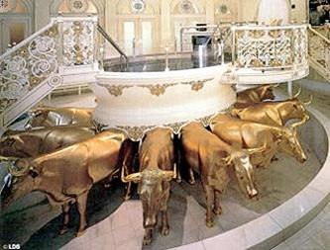
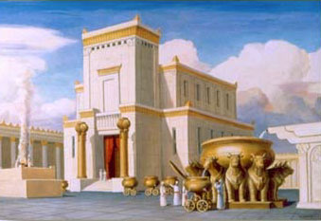
Baptisms for the Dead
D&C 124:26-29

Slide 5
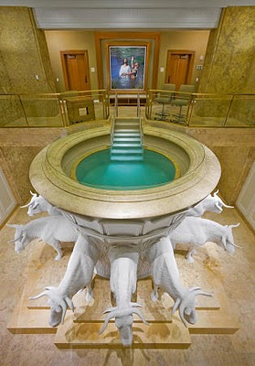
Michael Wilcox
The…font rests securely on the strong backs of the twelve oxen. They represent the tribes of Israel and we belong to those tribes.
It is totally appropriate that the font should be so situated. The saving ordinances for the world rest of the backs made strong by the blessings of the Restoration.
That weight will not be removed until every child of God is found.
With our heads directed to the four points of the compass, we desire and invite all to receive the ordinances that open the sanctifying power of the Atonement.
House of Glory, 124

Slide 6
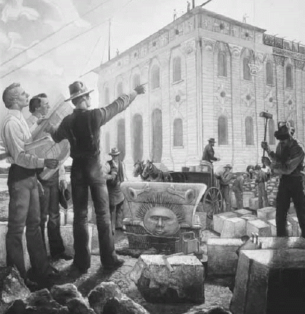
Divine Pattern
D&C 124: 43,44
And ye shall build [the temple] on the place where you have contemplated building it,
for that is the spot which I have chosen for you to build it.
If you labor with all your might,
I will consecrate that spot that is shall be made holy.

Slide 7
Called and Chosen
D&C 121: 34-37

Slide 8
Called and/or Chosen… or not!
Robert Thompson
Hyrum Smith
John C. Bennett
Lyman Wight
William Law
Robert D. Foster
Vinson Knight

Slide 9
Nauvoo House
D&C 124: 22-24, 60

Slide 10
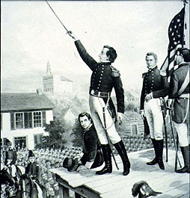
Plants of Renown
D&C 124: 60,61
Isaiah 63:1-3

