Slide 1
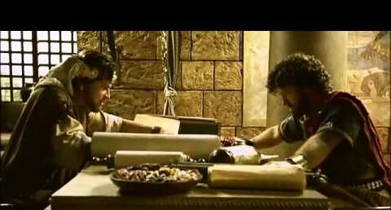
Josiah and the Deuteronomists

Slide 2
Biblical Scholar Margaret Barker at BYU
Babylonian Torah and Texts Suggest:
The Prophets worshipped:
God (El) And also his wife (Asherah)
Northern Kingdom Worshipped:
God (Yahwah) and his wife (Asherah)
Idol worshippers:
God (Ba’al) and his cohort (Asherah)

Slide 3
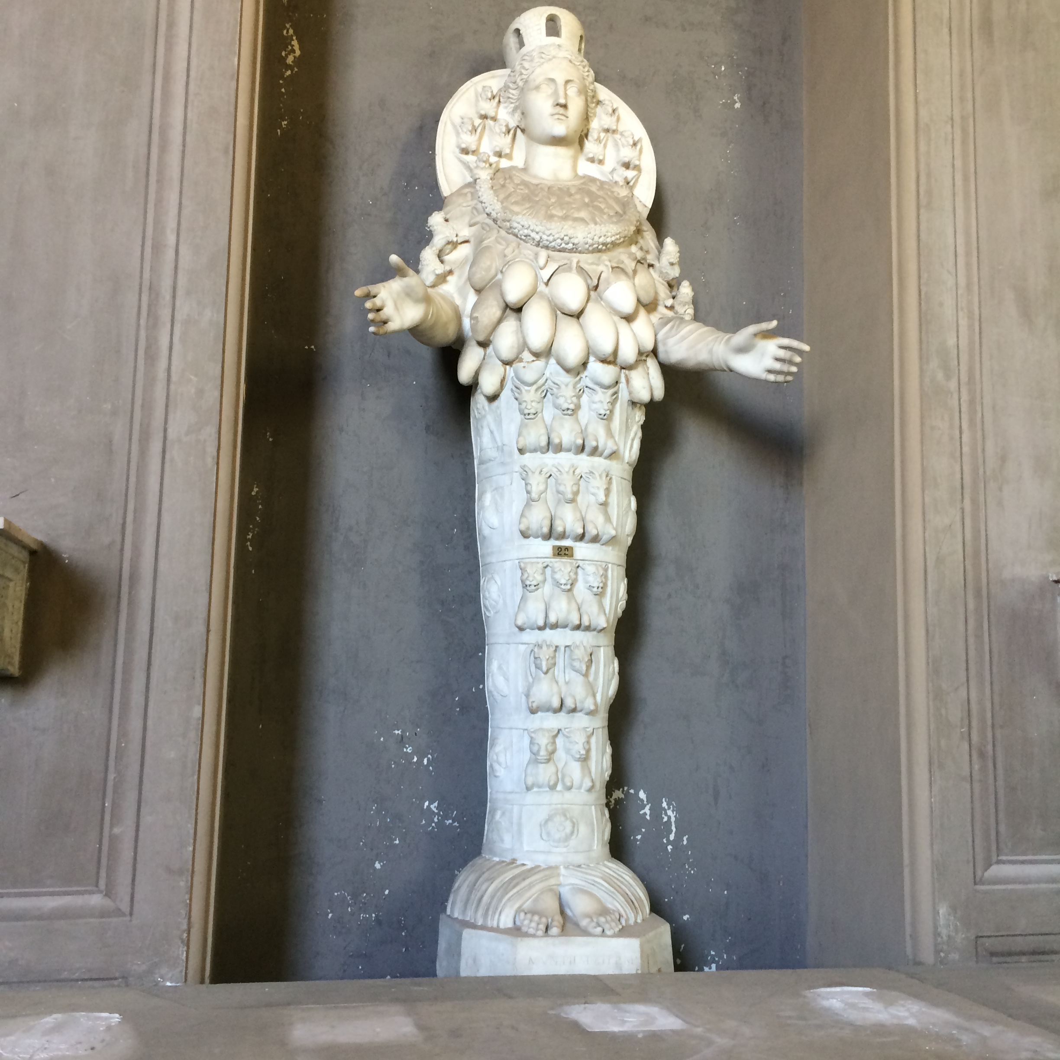
Diana or Artimus

Slide 4
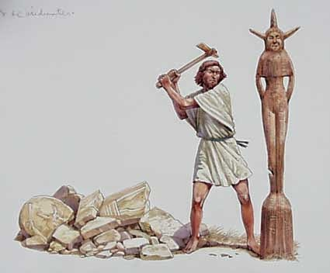
Converts
Emerged following the destruction and captivity of Israel (Northern Kingdom) in 721 B.C.
Refugees who escaped to Judah (Southern Kingdom)
Brought their “traditions” – most notably the concept of Yahweh as the only God who is to be worshipped and served
Initial “converts” to the new ideas were landowning aristocrats who were the administrative elite in Jerusalem
In Christ’s time, this group was known as Saducees.

Slide 5
Some Background, cont.
In 640, King Amon was murdered. The aristocrats suppressed an attempted coup, putting the perpetrators to death, and placing Amon’s 8-year old son, JOSIAH, on the throne.
Judah at this time was a vassal of Assyria, which was in a rapid decline in power, leading to a resurgence of nationalism.
In 622, Josiah launched his reform program, based on an early form of Deuteronomy, chapters 5-26, framed as a covenant (treaty) between Judah and Yahweh in which Yahweh replaced the Assyrian king.

Slide 6
Development of Deuteronomistic Theology
Josiah was deeply moved by the message of the “Book of the Law” when it was read to him, noting that violators of Israel’s covenant with God would be severely punished.
This commitment in hand, Josiah ordered a thoroughgoing purge of all non-Israelite forms of worship. Everything associated with these decayed forms of ritual were removed and burned, and the priests who had tended to them were banned.
In addition, Josiah outlawed worship at local shrines and “high places”, redirecting ALL ritual worship to the newly-cleansed temple in Jerusalem.

Slide 7
Deuteronomistic Theology 622 BC
The Book of the Law is supreme over all other sources of authority, including kings, royalty, and government officials, and temple priests.
Prophets are simply guardians of the law.
Prophecy is instruction about the laws given to Moses.
Law revealed to Moses is complete and sufficient – nothing further is to be added or deleted.
All worship is centralized in Jerusalem at the Temple.
No more prophets after Moses would receive visions, dreams or other forms of divine communication.

Slide 8
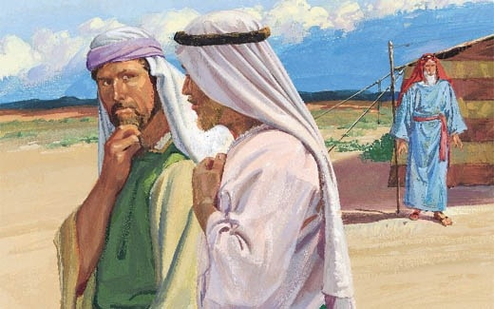
Laman and Lemuel as Deuteronomists
Laman and Lemuel appear to have been orthodox, observant Jews
Nephi never accuses them of idolatry, false swearing, Sabbath breaking, drunkenness, adultery, or ritual uncleanness.
In fact, Nephi characterizes has brothers “like unto the Jews who were at Jerusalem” (1 Nephi 2:13)
The “gatekeepers” of Jewish “orthodoxy” at the time of Lehi were the Deuteronomists and it appears that Laman and Lemuel had adopted much of their theology based on their words and actions

Slide 9
Murmuring at the Altar
When Lehi arrived at the first camp site, “he built an altar of stones and made an offering to the Lord” (1 Nephi 2:7)
Strict interpretation of the legal codes prescribed by the Deuteronomists prohibited sacrifice by non-Levites outside the Temple in Jerusalem.
Laman and Lemuel began murmuring against their father “immediately” after Lehi sacrifices at the altar. (1 Nephi 2: 11-12)

Slide 10
“Visionary Man”
Numbers 12:6 if there be a prophet among you, I the Lord will make myself known unto him in a VISION, and will speak to him in a DREAM.”
1 Nephi 2:1 – ‘the Lord spoke to my father in a dream”
Deuteronomistic ideaolgy rejected visions as a means of knowing the Lord’s will. Moses was the last prophet to have visions and dreams.
Use of the phrase “visionary” man by L&L was more than ridicule, derision, or name-calling.
It was an accusation that Lehi was a false prophet.

Slide 11
“Jerusalem, that great city”
Many prophets had predicted / prophesied as to the potential destruction of Jerusalem if the tribe of Judah did not repent.
Lehi had been told to preach that message , which was not well received.
Laman and Lemuel were desirous to return to the land of Jerusalem (1 Nephi 7:7) rather than being exposed to the risks of death in the wilderness.
L&L did not believe that Jerusalem could or would be destroyed according to the words of many prophets, including their father.
The recent reforms of Josiah had given the inhabitants of Judah an undue sense of self and community righteousness which they believed would surely preserve them from any threatened destruction.
Josiah’s reforms in conjunction with Judah’s perception of the invincibility of their magnificent city promised in the Davidic covenant and the miraculous deliverance from enemies during the reign of Hezekiah reinforced the people’s belief that the great city of Jerusalem could not and would not be destroyed.
Josiah was depicted as “David II”

Slide 12
Murderous Intent
Lehi received visions and dreams and prophesied much which was not pleasing to those living in Judah.
Orthodox Jews would have rejected Lehi and his message.
L&L would have been aware of and most likely subscribed to the scriptural penalty for false prophets; namely = DEATH.
(Deut. 18:20 and 13:1-11).
No exception was made for family members claiming prophetic callings.

Slide 13
The Law as Final Arbiter of “Righteousness
Deuteronomists heavily emphasized the Law
Josiah’s decade of reform and giving kingly sanction to the Deuteronomy.
Moses was the great Lawgiver and The Torah was the only Law.
“And we know that the people who were in the land of Jerusalem were a righteous people; for they kept the statutes and judgments of the Lord, and all his commandments, according to the Law of Moses; wherefore we know that they are a righteous people.” (1 Nephi 17:22)
The law of Moses as taught in the Book of Mormon is never seen as an end in and of itself; rather, it is a type and shadow of Christ.
Nephi’s soul was “rent with anguish” after L&L’s insistence that that Law was what made all men righteous (1 Nephi 17:47)

Slide 14
Another “Joseph”—Youngest to Rule
Nephi, on more than one occasion alluded to the conflict between Joseph and his brothers.
Joseph, like Nephi, was chosen to rule over his older brothers.
Deuteronomists opposed traditions grounded in the old “wisdom literature”
(the other four books of Moses)
L&L reacted as Deuteronomists in their first rebellion
“…take Nephi and bind him and let his body be devoured by wild beasts” (1 Nephi 7:16)

