Slide 1
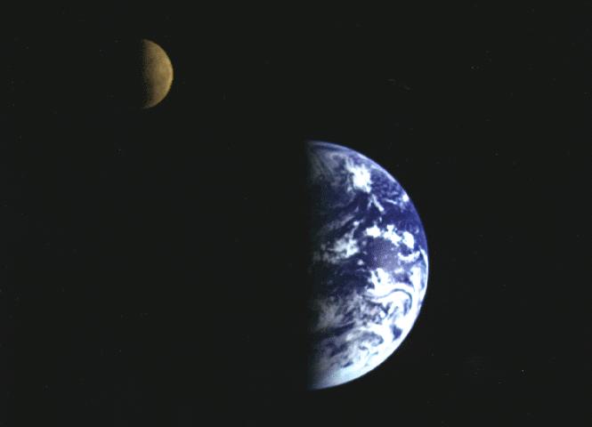
The Vision
www.kevinhinckley.com

Slide 2
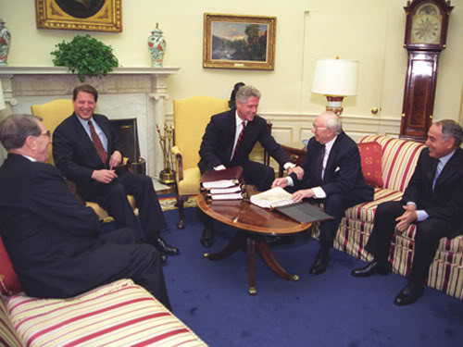
Bill Clinton
During Clinton’s young years in Hot Springs, Ark., two Mormon missionaries once approached the future president with their pitch.
The then-president-to-be was impressed, he told reporters recently, with the young preachers’ effort as they explained Mormon teachings about heaven.
As Clinton recalled, they described the afterlife as "a pyramid with many levels that put Hitler and Stalin at the very bottom, faithful Mormons on top, and everyone else in between."
That had a certain appeal, he said, but for Clinton, a Baptist, "the sticking point" was any system that left his loved ones "out of the top level."
He couldn’t get with any program, he said, that would "leave all these other people behind."

Slide 3
Education Week Email
For some years, I dreaded having the knowledge that came to those who heard King Benjamin's address--the part where they recognized their nothingness, and were face down on the ground. At the mention of that scene, I would feel my teeth clench, and my mind form an internal wince.
Then one day, I heard this thought in my mind: "God does not get his joy by buying a new RV". Well, that surprised me, because I never for a second assumed that he did. Still, I spend quite a while contemplating God, and God's sources of joy.
I finally came to realize that we are his source of joy. I had always seen God as the ultimate 'man who has everything' and that there was nothing I had to give to him--he gives me everything, he blesses me, when I am righteous, he gives me more, and He will always be ahead, and I will always be behind.
While there is truth in that, I now understand that I am his source of joy. I hold in my weak, mortal hands power to give Heavenly Father and Jesus Christ joy that they cannot get from any other source.
I hold that thought close. I am warmed by it. I find joy in it. I am not replaceable. If I do not give him that joy, he goes without it. When I think about that, I want to give him joy. I have heard "keep the commandments" for so long that I have developed a callous and I don't connect the depth of meaning that phrase carries.
When I think "I have the power to give God joy that he cannot get from any other source," I feel my chest fill and it seems my soul expands and I want to keep his commandments. At those moments, I sense a tiny bit of how important I am.

Slide 4
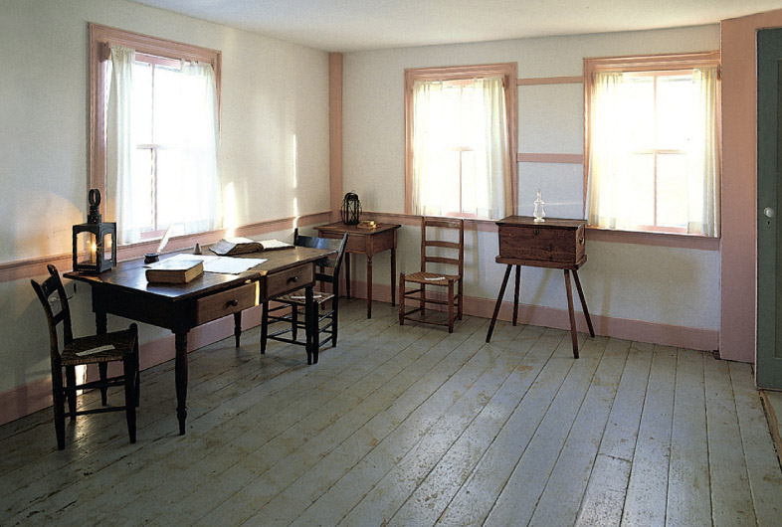
The Vision (Section 76)
Significance to the Saints
How Revelations are received
New Doctrines

Slide 5
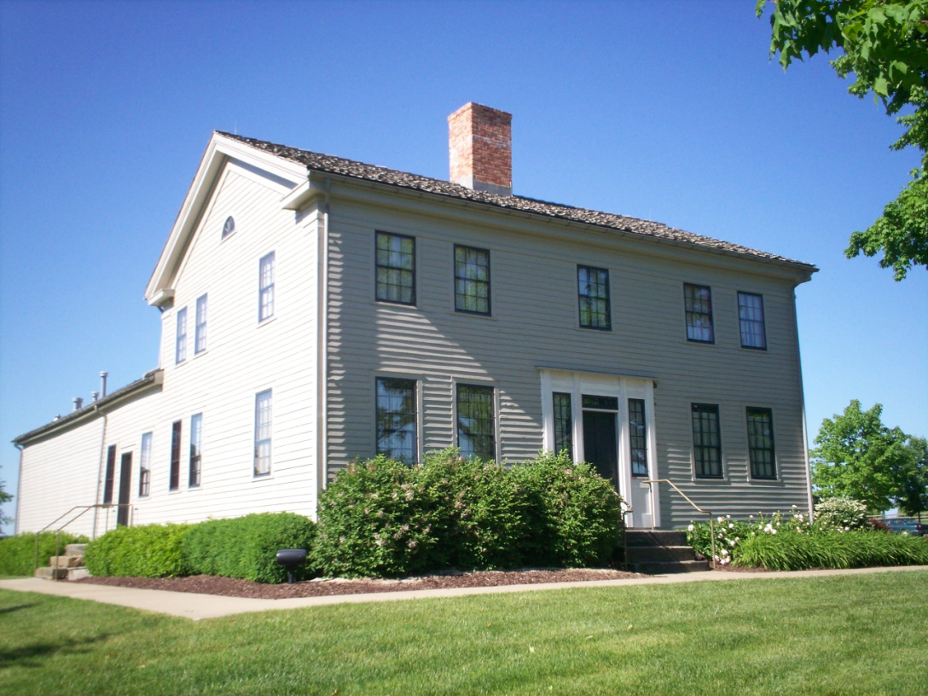
Philo Dibble
On a subsequent visit to Hiram, I arrived at Father Johnson's just as Joseph and Sidney were coming out of the vision alluded to in the Book of Doctrine and Covenants [D&C 76], in which mention is made of the three glories.
Joseph wore black clothes, but at this time seemed to be dressed in an element of glorious white, and his face shone as if it were transparent, but I did not see the same glory attending Sidney [Rigdon].
Joseph appeared as strong as a lion, but Sidney seemed as weak as water, and Joseph, noticing his condition smiled and said, "Brother Sidney is not as used to it as I am."

Slide 6
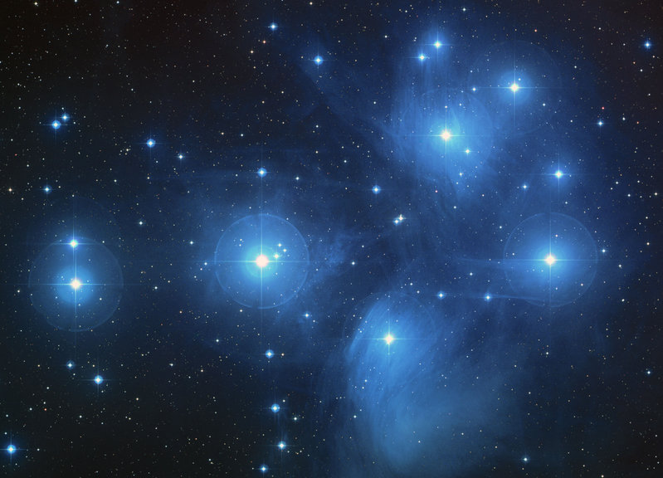
Joseph’s Reaction
"Nothing could be more pleasing to the Saints upon the order of the Kingdom of the Lord, than the light which burst upon the world through the foregoing vision.
Every law, every commandment, every promise, every truth, and every point touching the destiny of man, from Genesis to Revelation…
go to show the perfection of the theory (of different degrees of glory in the future life)
and witness the fact that that document is a transcript from the records of the eternal world. (D. H. C. 1:252-3.)

Slide 7
W.W. Phelps 1843 “Vade Mecum”
Go with me, will you go to the Saints that have died
To the next better world where the righteous reside?
Where the angels and spirits in harmony be,
In the joys of a paradise vast?—Go with me.
Go with me where the truth and the virtues prevail;
Where the union is one, and the years never fail;
Not a heart can conceive, nor a nat'ral eye see
What the Lord has prepar'd for the just.—Go with me.

Slide 8
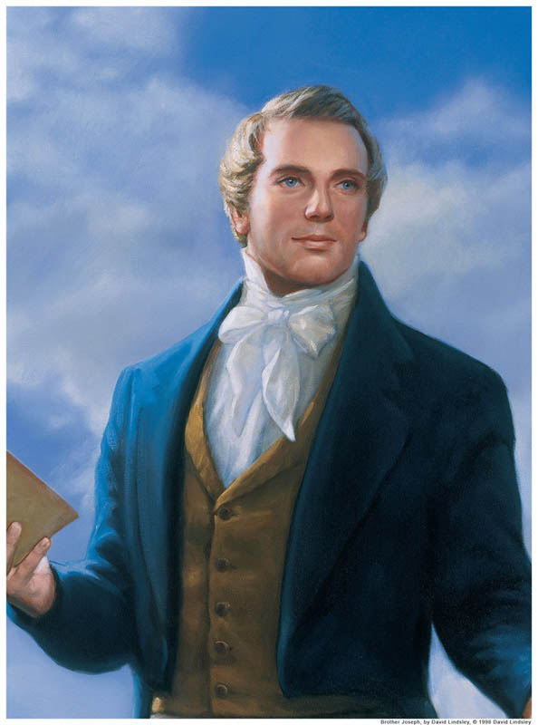
Joseph’s Response “I will go”
312 Line Poem
Commentary on The Vision
11 Years Later
Additional Insights

Slide 9
New Insight
D&C 76
And we beheld the glory of the Son, on the right hand of the Father and received of his fulness;
And saw the holy angels, and them who are sanctified before his throne, worshiping God and the Lamb, who worship him forever and ever
The Vision
Hosanna, for ever! They open'd anon,
And the glory of God shone around where I was;
And there was the Son at the Father's right hand,
In a fulness of glory and holy applause.
I beheld round the throne holy angels and hosts,
And sanctified beings from the worlds that have been,
In holiness worshipping God and the Lamb,
For ever and ever. Amen and amen.

Slide 10
More Insight…
24 That by him and through him and of him, the worlds are and were created,
and inhabitants thereof are begotten sons and daughters of God.
And I heard a great voice bearing record from heav'n,
He's the Saviour and only begotten of God;
By him, of him, and through him, the worlds were all made,
Even all that career in the heavens so broad.
Whose inhabitants, too, from the first to the last,
Are sav'd by the very same Saviour of ours;
And, of course, are begotten God's daughters and sons
By the very same truths and the very same powers.

Slide 11
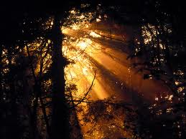
The Lord’s Preface
D&C 76: 1-10

Slide 12
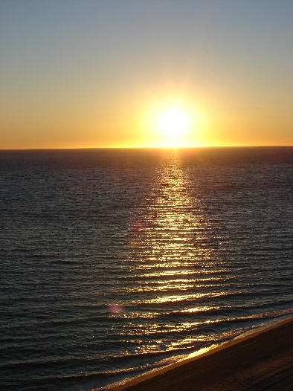
Elder C.S. Lewis
“My own plans are made. While I can, I sail east in the Dawn Treader.
When she fails me, I paddle east in my coracle.
When she sinks, I shall swim with my four paws.
And when I can swim no longer, if I have not reached Aslan’s country…
I shall sink with my nose to the sunrise.” ― C.S. Lewis, The Voyage of the Dawn Treader

