Slide 1
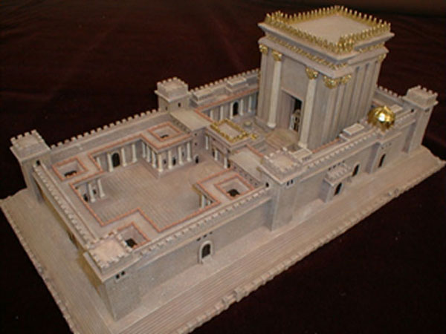
Sacred People, Sacred Times D&C 58,59
www.kevinhinckley.com

Slide 2
Flight Attendants…
On landing, the stewardess said, 'Please be sure to take all of your belongings. If you're going to leave anything, please make sure it's something we'd like to have.
After a particularly rough landing during thunderstorms in Memphis, a flight attendant on a Northwest flight a announced, 'Please take care when opening the overhead compartments because, after a landing like that, sure as shootin’, everything’s shifted.'
'Welcome aboard Southwest Flight 245. To operate your seat belt, insert the metal tab into the buckle, and pull tight. It works just like every other seat belt; and, if you don't know how to operate one, you probably shouldn't be out in public unsupervised.'
'In the event of a sudden loss of cabin pressure, masks will descend from the ceiling. Stop screaming, grab the mask, and pull it over your face. If you have a small child travelling with you, secure your mask before assisting with theirs. If you are travelling with more than one small child, pick your favorite.'
'Weather at our destination is 50 degrees with some broken clouds, but we'll try to have them fixed before we arrive…
'Your seat cushions can be used for flotation; and, in the event of an emergency water landing, please paddle to shore and take them with our compliments.'

Slide 3
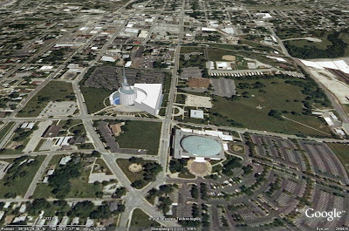
D&C 57: 1-4 D&C 58:1-5

Slide 4
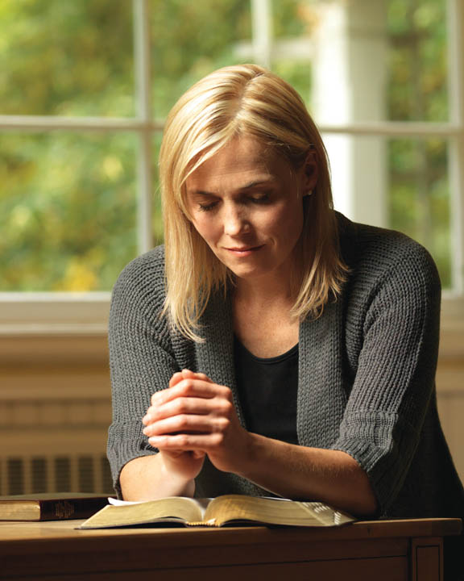
More preparation…
D&C 59:4-6

Slide 5
Neal A. Maxwell
The first commandment does not read, “Thou shalt love the Lord thy God as thyself.”
This would be both too little and the wrong kind of love.
Nor does the second commandment read, “Thou shalt love they neighbor with all thy heart, mind, soul, and strength.”
This would be neighbor worship.
Whereas our Perfect Father can be trusted with our bestowal of all our devotion of heart, mind, soul, and strength, we cannot.
Nor can our neighbor.
Moreover, only when proper love of God comes first can our love of self and neighbor be safely shaped and nurtured.
(Notwithstanding My Weakness, 24 - 25.)

Slide 6
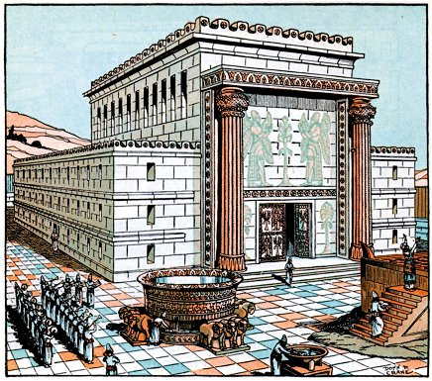
The Law of Moses
Three Types of Sacrifices/Offerings
Trespass (Guilt) Offerings
2) Burnt Offerings
-Burning of the whole animal
-Whole Surrender
-Constant, daily offering
3) Peace Offerings
-At peace
-Gratitude, gladness

Slide 7
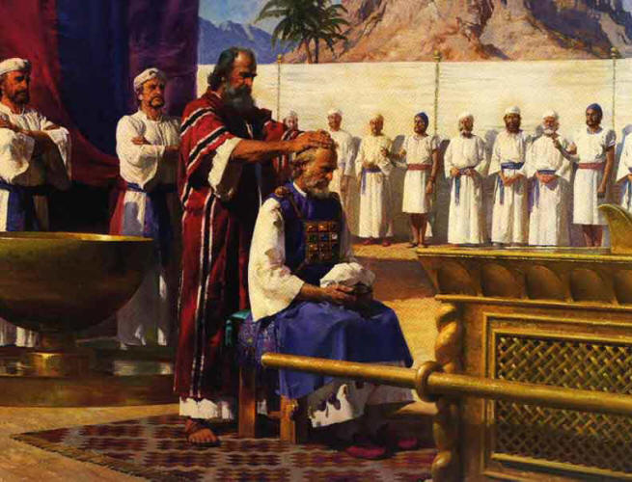
Spiritual Power
Sacred
Places
Sacred
Times
Sacred
People

Slide 8
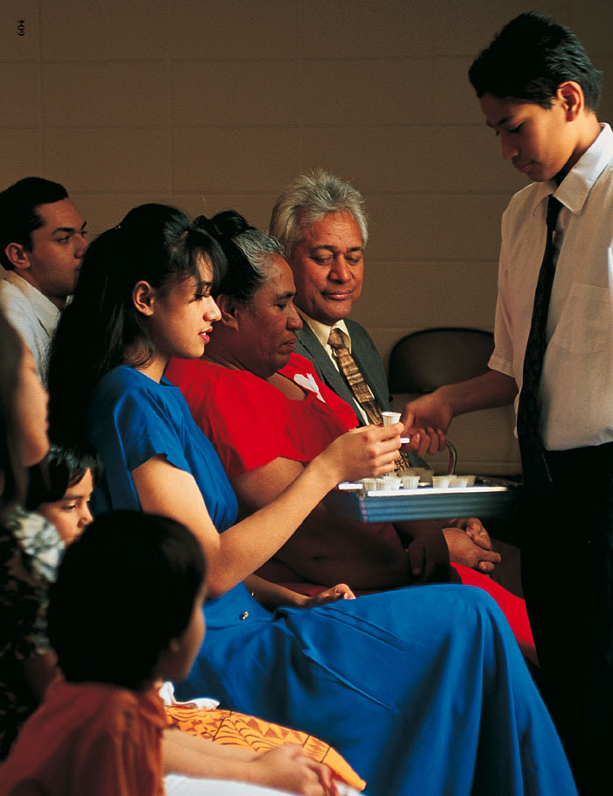
Law of Moses
Sin Offerings
Burnt Offerings
Peace Offerings
Sacrament
Forgiveness of our sins
Surrender:
Offer our whole time, talents and efforts
We Offer the Lord:
Gratitude, Love

Slide 9
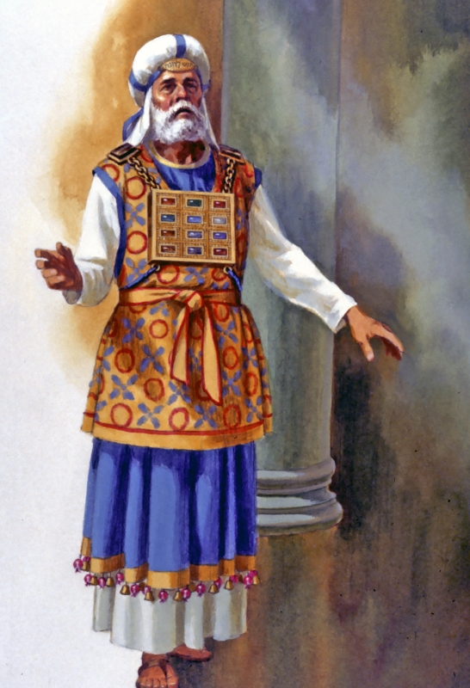
Sacred People
D&C 59:9-12

Slide 10
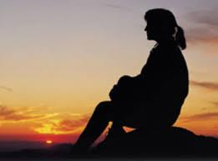
Purpose of Fasting
D&C 59: 13,14

Slide 11
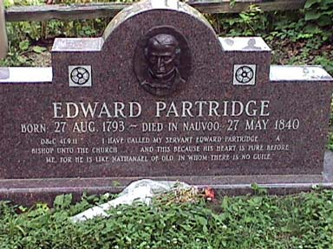
Edward Partridge
D&C 41:9,11
D&C 58: 14-18

