Slide 1
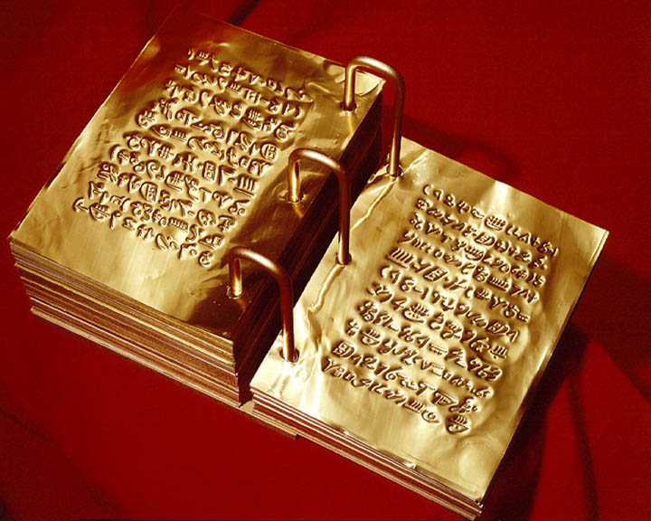
The Book of Mormon
www.kevinhinckley.com

Slide 2
Lesson #1
What is the purpose of the Book of Mormon?

Slide 3
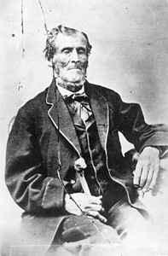
The Lost 116 Pages
Martin Harris
D&C 10:1,6,7

Slide 4
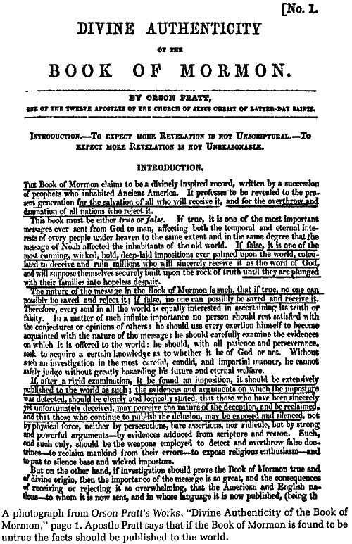
However…
D&C 10:45, 46

Slide 5
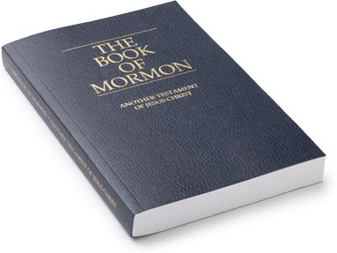
Jeffrey R. Holland
So clearly this was not a quid pro quo in the development of the final Book of Mormon product. It was not tit for tat, this for that—116 pages of manuscript for 142 pages of printed text. Not so.
We got back more than we lost. And it was known from the beginning that it would be so.
We do not know exactly what we have missed in the lost 116 pages, but we do know that what we received on the small plates was the personal declarations of three great witnesses (Nephi, Jacob, Isaiah), three of the great doctrinal voices of the Book of Mormon, testifying that Jesus is the Christ. (“For a Wise Purpose,” Ensign, Jan. 1996, 13–14)

Slide 6
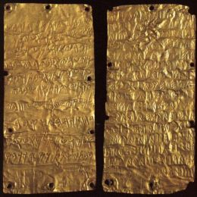
1 Nephi to Mosiah 1
Small Plates of Nephi
“Greater Views of my Gospel
3 Witnesses
Nephi
Jacob
Isaiah
Mosiah 1 to Moroni 10
Mormon’s Abridgement
“all those parts of my gospel which my holy prophets desired…should come forth unto this people”
Alma, Helaman, Nephi

Slide 7
Lesson #2
What did Joseph learn about Joseph?

Slide 8
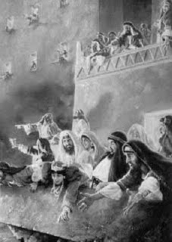
Spiritual Maturity
D&C 3: 7-9

Slide 9
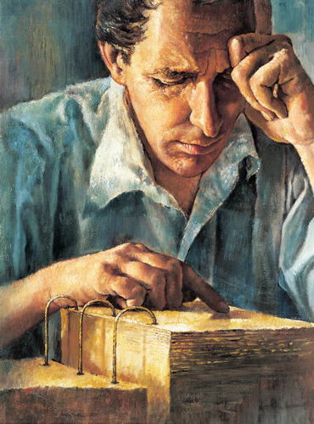
Gifts
D&C 5:4,30, 31,34

Slide 10
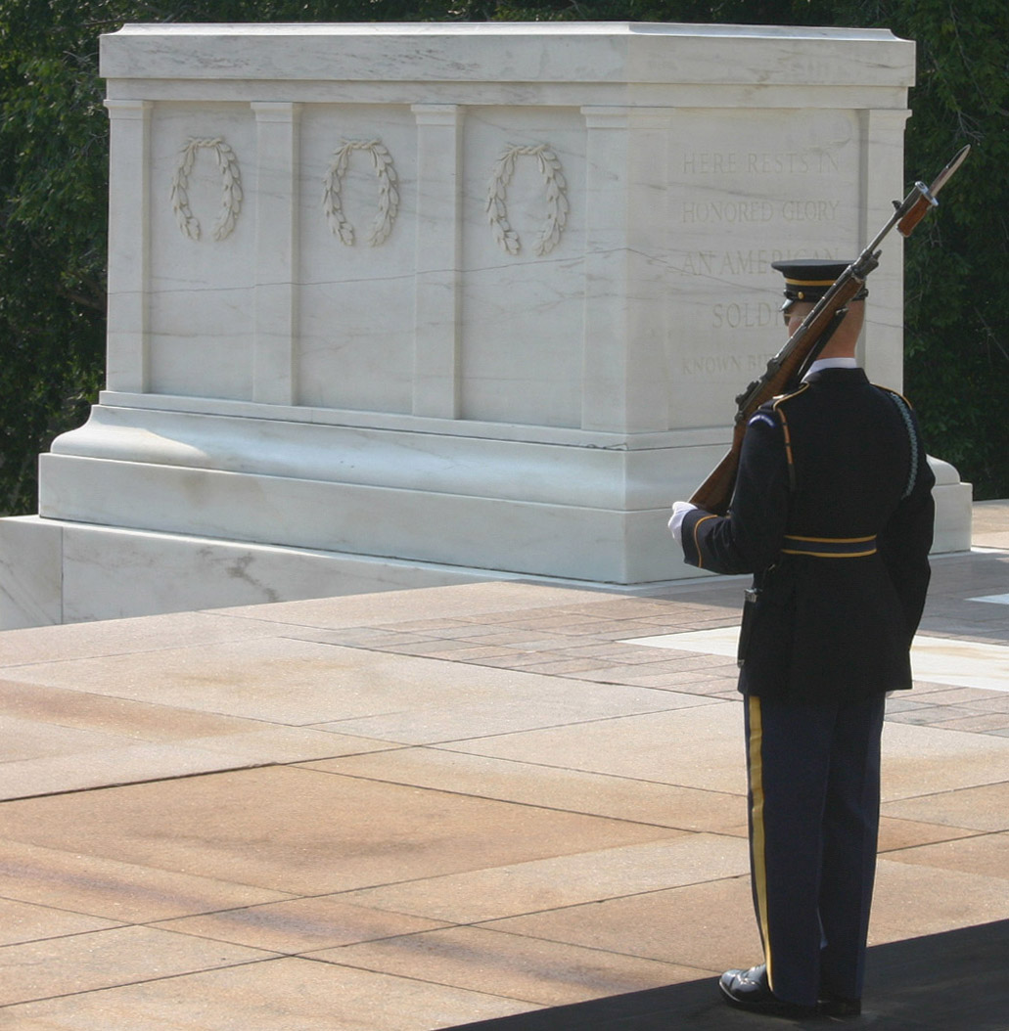
Principle:
Stop and Stand Still

